Slide 1
Lecture 5
STAT 451 VISUALIZING DATA
Fall 2024
Many thanks to Prof. Abel Rodriguez, many slides from this course are adapted from his data visualization class.

Slide 2
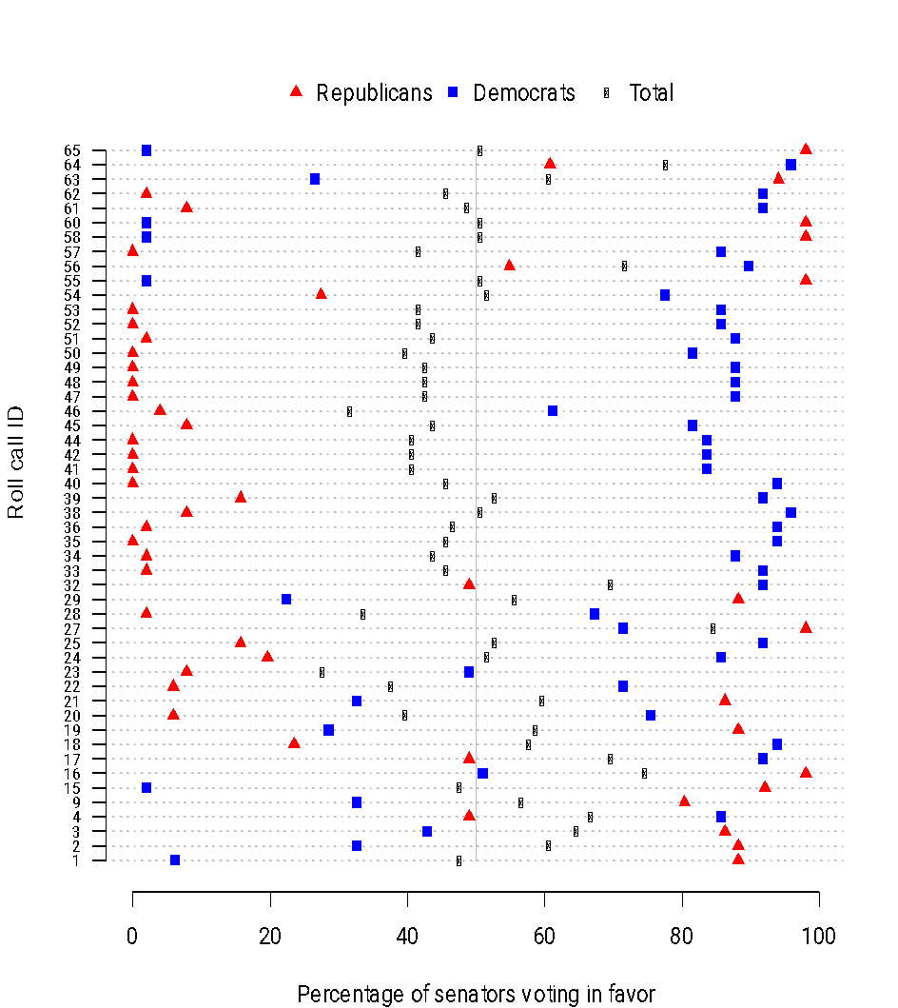
Encoding through shape
Different shapes can be very helpful to represent categorical variables.
In this case, symbols are used redundantly with colors.

Slide 3
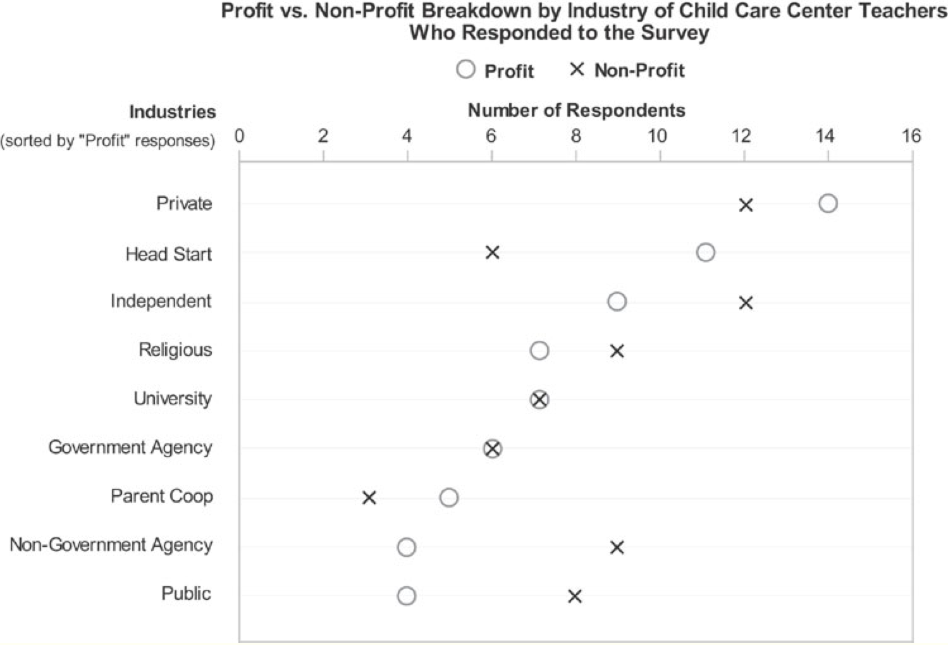
Encoding through shape
When multiple points are plotted on each line and overlaps exist, carefully selecting the symbols and avoiding fillings is key to make the graph legible!
What would be good options if you were to plot a third variable?

Slide 4
Encoding through shape
However …
“Pre-attentive symbols become less distinct as the variety of distracters increases. It is easy to spot a single hawk in a sky full of pigeons, but if the sky contains a greater variety of birds, the hawks will be more difficult to see. A number of studies have shown that the immediacy of any pre-attentive cue declines as the variety of alternative patterns increases, even if all the distracting patterns are individually distinct from the target.”
Colin Ware (2000) “Information Visualization: Perception and Design”.

Slide 5
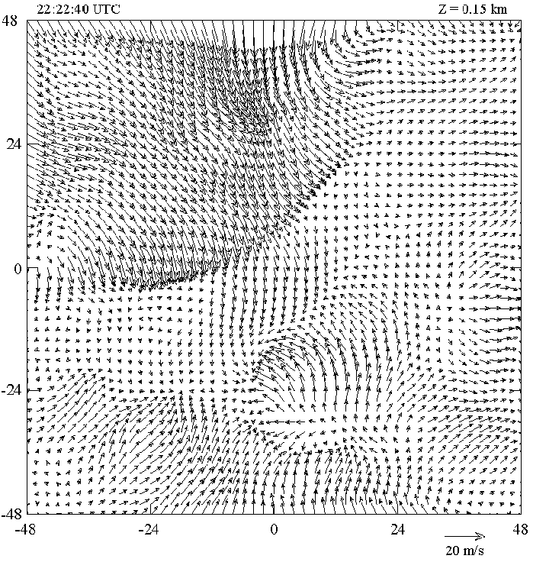
Encoding through shape
Symbols can also be used to encode continuous data.
Symbols have multiple dimensions that can be exploited to represent multiple variables simultaneously.
Wind speed graph
Direction of the arrow tells you wind direction.
Length tells you wind speed.
Using too many dimensions to encode data can lead to graphs that are hard to read.

Slide 6
Visualizing many variables simultaneously: Chernoff’s faces
Used to represent many variables simultaneously (up to 18).
Each feature (height and width of face, size of eyes and ears, etc.) encodes a different variable.
Based on the idea that humans can pre-attentively differentiate faces.
This could be decorative, but it is also functional!
Note that we are not equally good at perceiving differences in all features: order of the variables might matter!

Slide 7
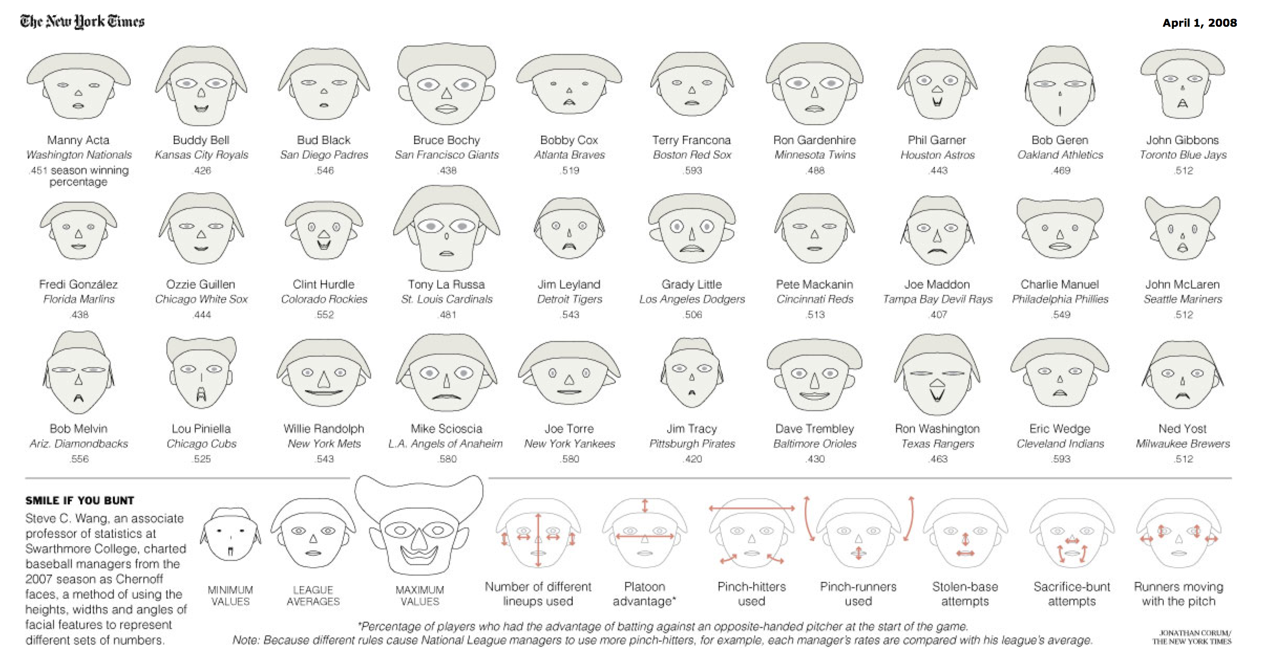
Chernoff’s faces
http://www.nytimes.com/2008/04/01/science/01prof.html?ex=1364702400&en=c8f70d006f87dbd9&ei=5088&partner=rssnyt&emc=rss

Slide 8
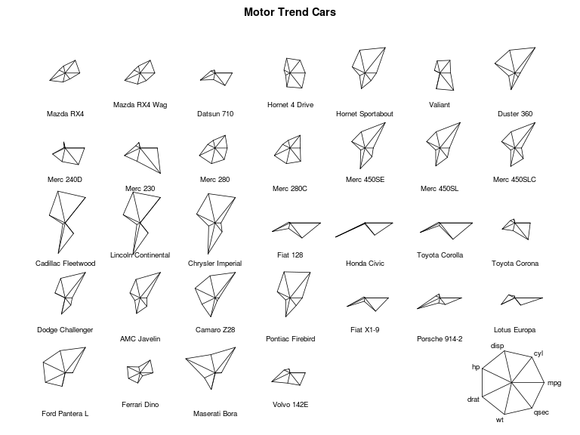
Star plots
An alternative to Chernoff’s faces.
They are not as decorative, but they have the advantage of treating all variables equally.

Slide 9
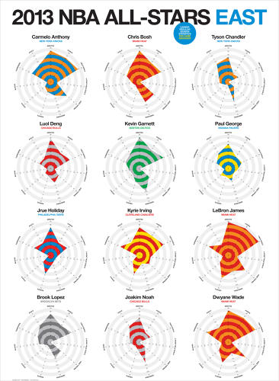
Star plots
http://e.fastcompany.net/multisite_files/fastcompany/imagecache/slideshow_large/slideshow/2013/12/
3023118-slide-1671897-inline-inline-zoom-all-stars-east.jpg

Slide 10
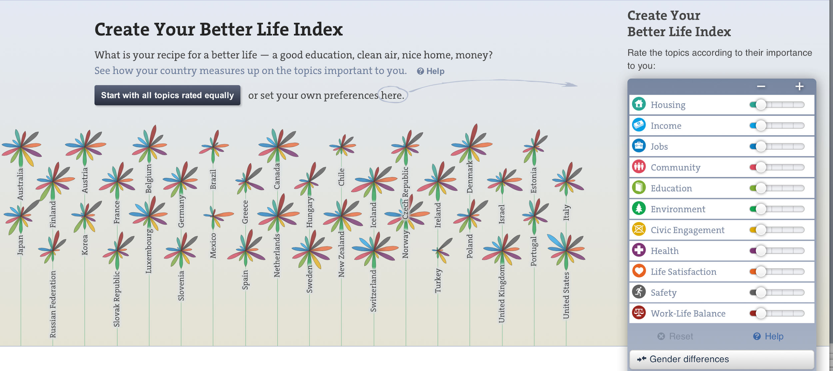
A decorative version of star plots
A decorative variant of this graph that uses flowers instead of stars (with each petal encoding one variable) can be seen at
http://www.oecdbetterlifeindex.org
The length of the petal represents the country score on that variable, the width the importance you have assigned to it, the position on the y axis the weighted average (index).

Slide 11
Encoding through shape
Remember that, when using lines to represent your data, additional information can be encoded through:
Categorical data: Line style (solid, dashed, dotted, dashed-dotted)
Either categorical or quantitative: Line width.
Line styles don’t work as well as well chosen colors to encode categorical variables.
Line widths can be effective at showing the “big picture” but do not allow for accurate comparisons.

Slide 12
Take-home message
When representing continuous data, remember the scale, but also keep in mind what the goal of the particular graph is:
If accurate comparisons are important, try to focus on visual cues at the top of the cognitive hierarchy (position, length).
If accurate comparisons are not important, then it is ok to use visual cues at the bottom of the hierarchy.
Remember that some level of redundancy might be useful.
Some visual cues can be used to emphasize … be careful not to mislead

Slide 13
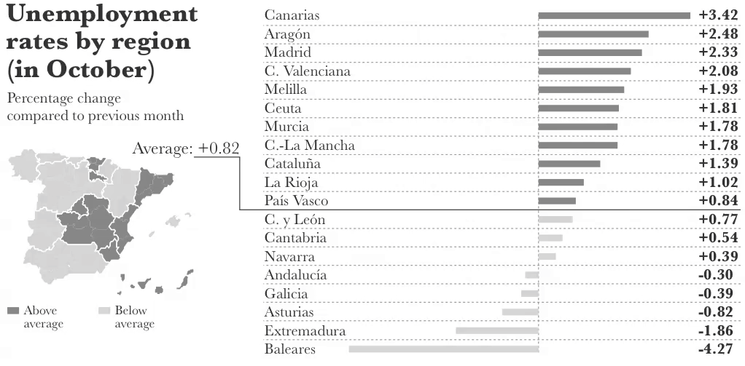
Take-home message
Accurate comparisons using the bar plot (position). Color used as a visual cue to point out regions above/below average
General geographic sense from the map (color is fine here because we do not want to use the map for detailed comparisons).
From “The Functional Art”, page 38.

Slide 14
Coordinate systems
The structured space and rules that dictate where the different shapes, lengths and colors go.
Cartesian (Euclidean): Easier to understand.
Polar: Less intuitive, but more appropriate for certain types of data (e.g., periodic).
Geographic: Helps us relate the numbers to specific location in the physical world.

Slide 15
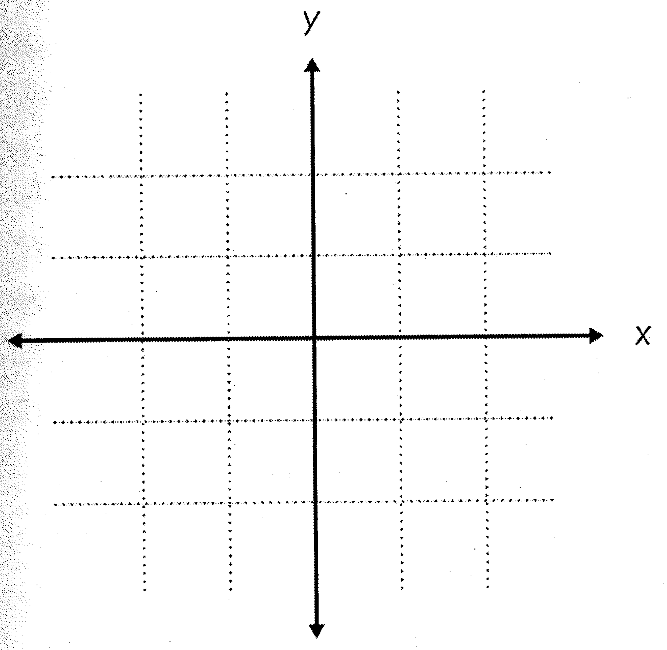
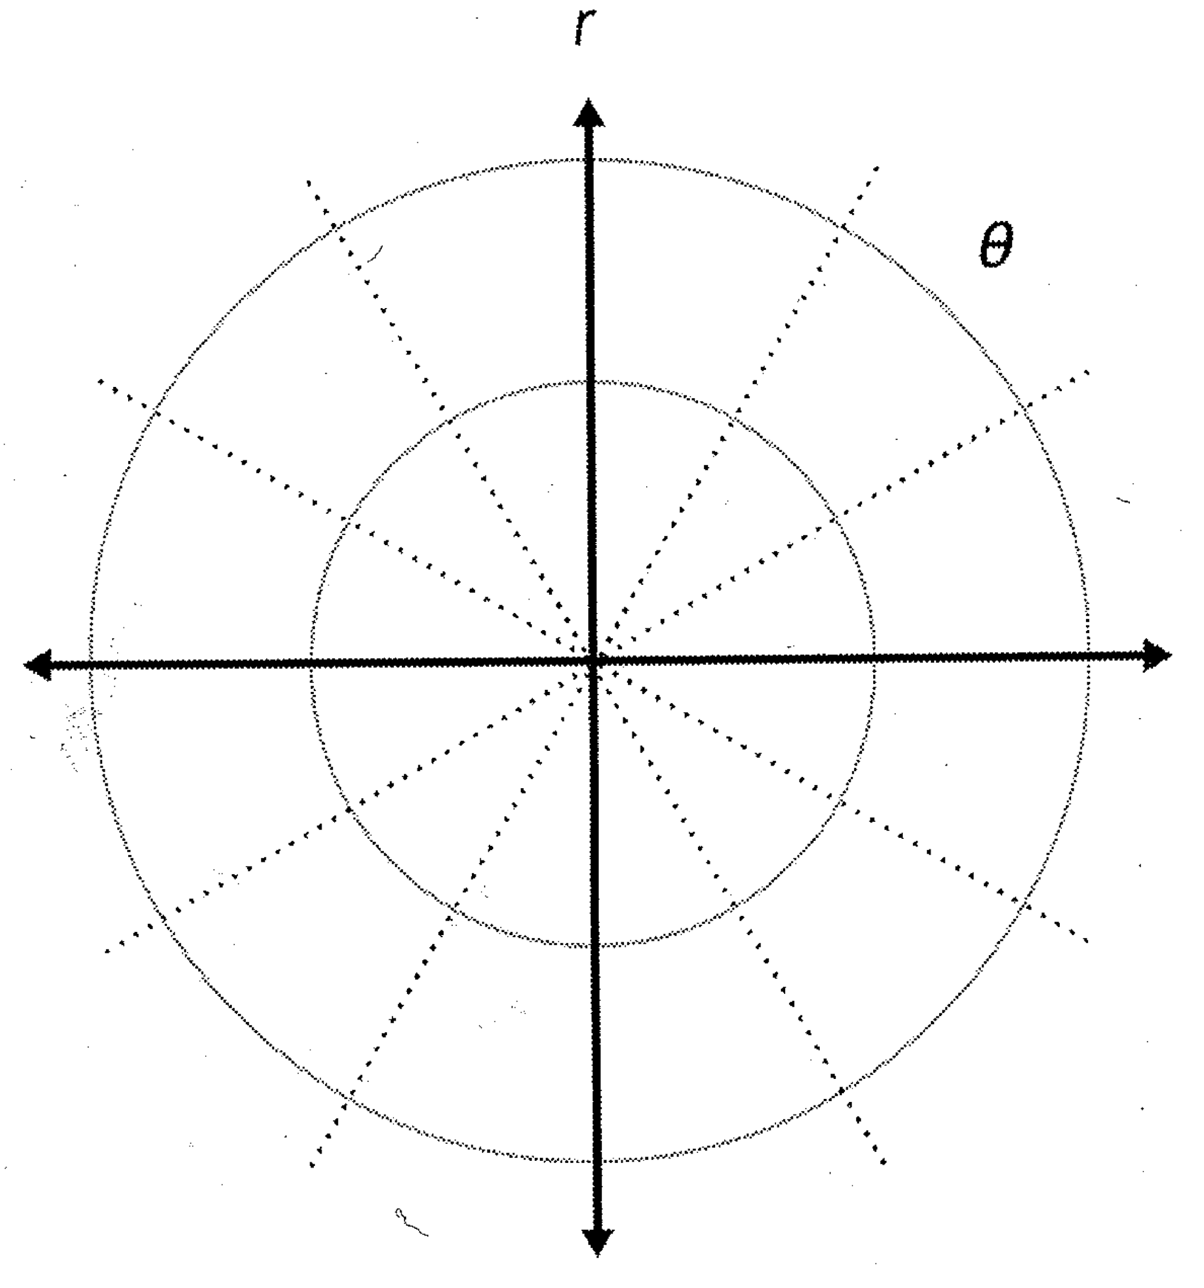
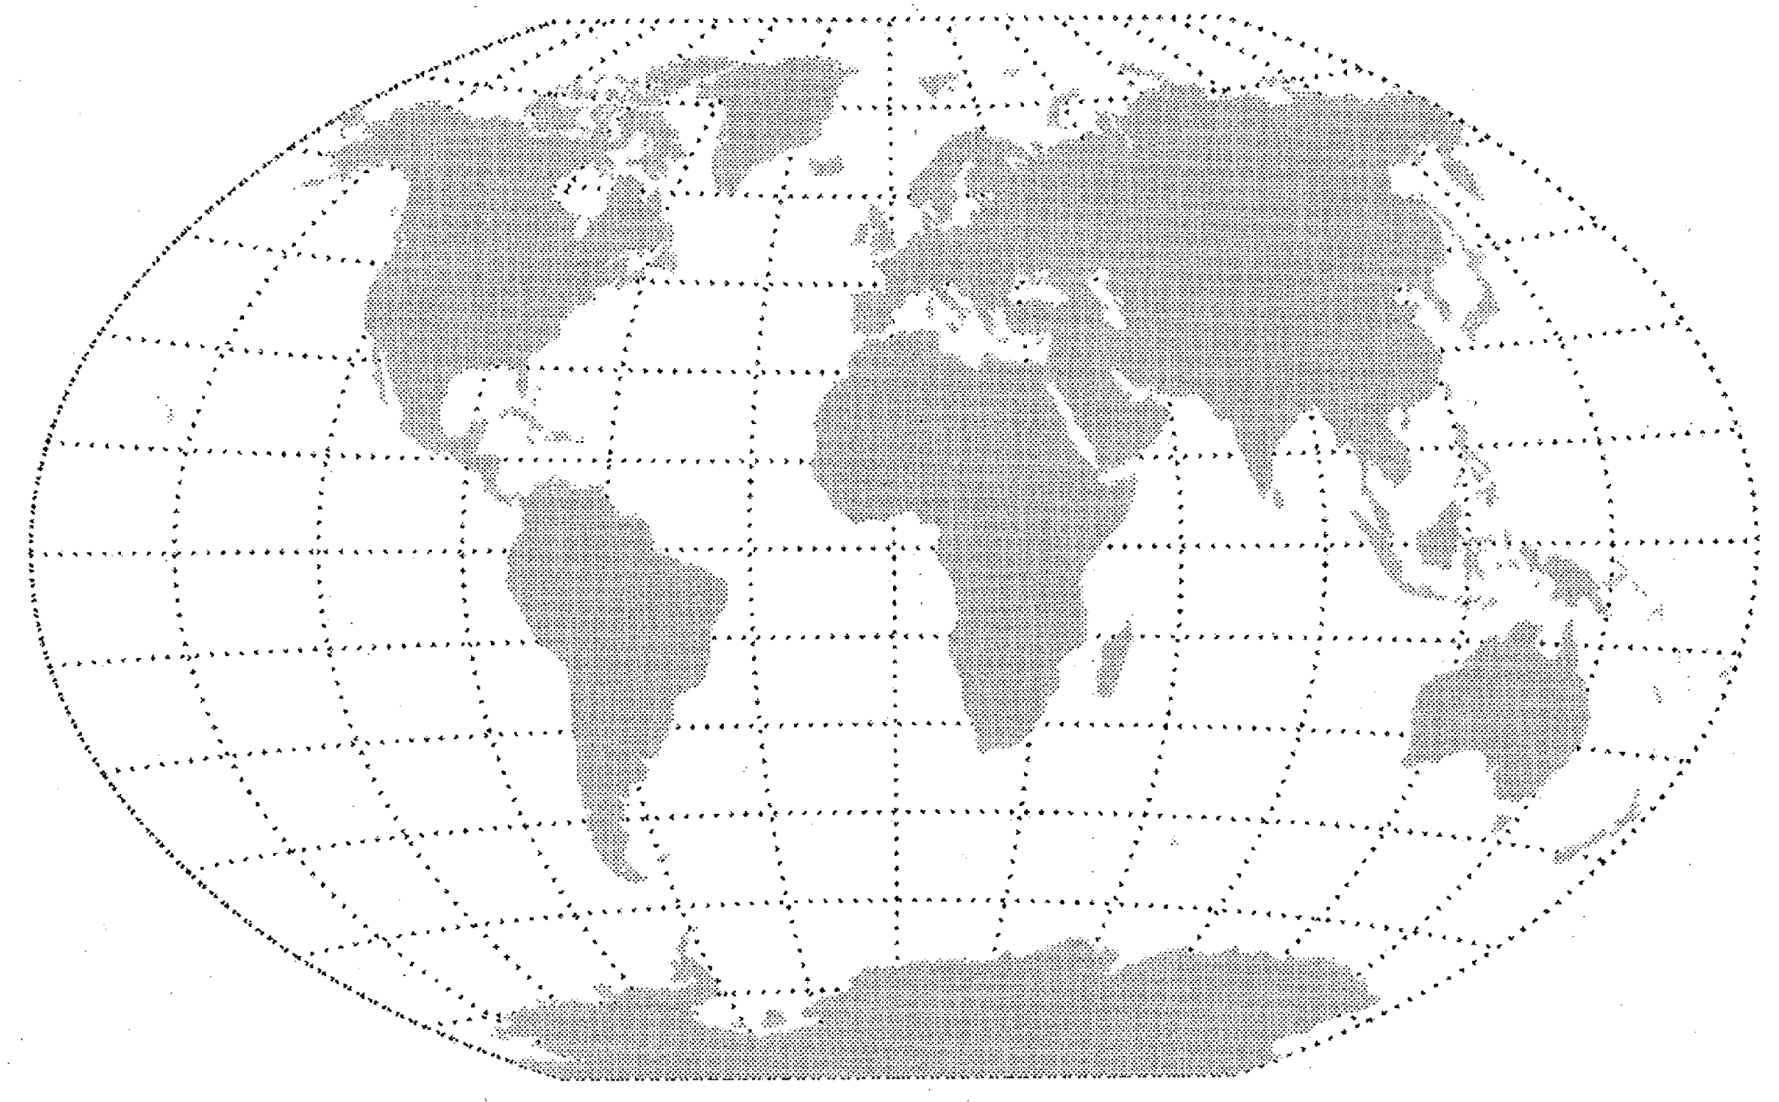
Coordinate systems
Cartesian
Polar
Geographic

Slide 16
Cartesian coordinate systems
Defined by perpendicular axes (horizontal x axis and vertical y axis).
Position of an object in 2D space is given by a pair (x, y) that identifies the location on each of these two axes.
The most common coordinate system.
Easy to understand and best from a pre-attentive point of view: Distances between two points are measured on a straight line.

Slide 17
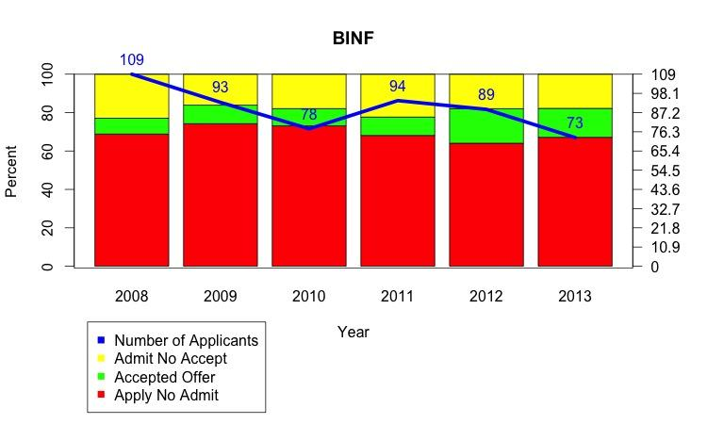
Cartesian coordinate systems
Sometimes it is useful to include two different sets of coordinates in the same graph.
Some authors absolutely discourage this practice!
http://www.perceptualedge.com/articles/visual_business_intelligence/dual-scaled_axes.pdf
If you do it (and I don’t recommend it), make sure you label the two axes clearly to avoid confusions! Context is key here.
There is no label for this scale, what does it correspond to?
Furthermore, is this scale associated with the bars or the lines?

Slide 18
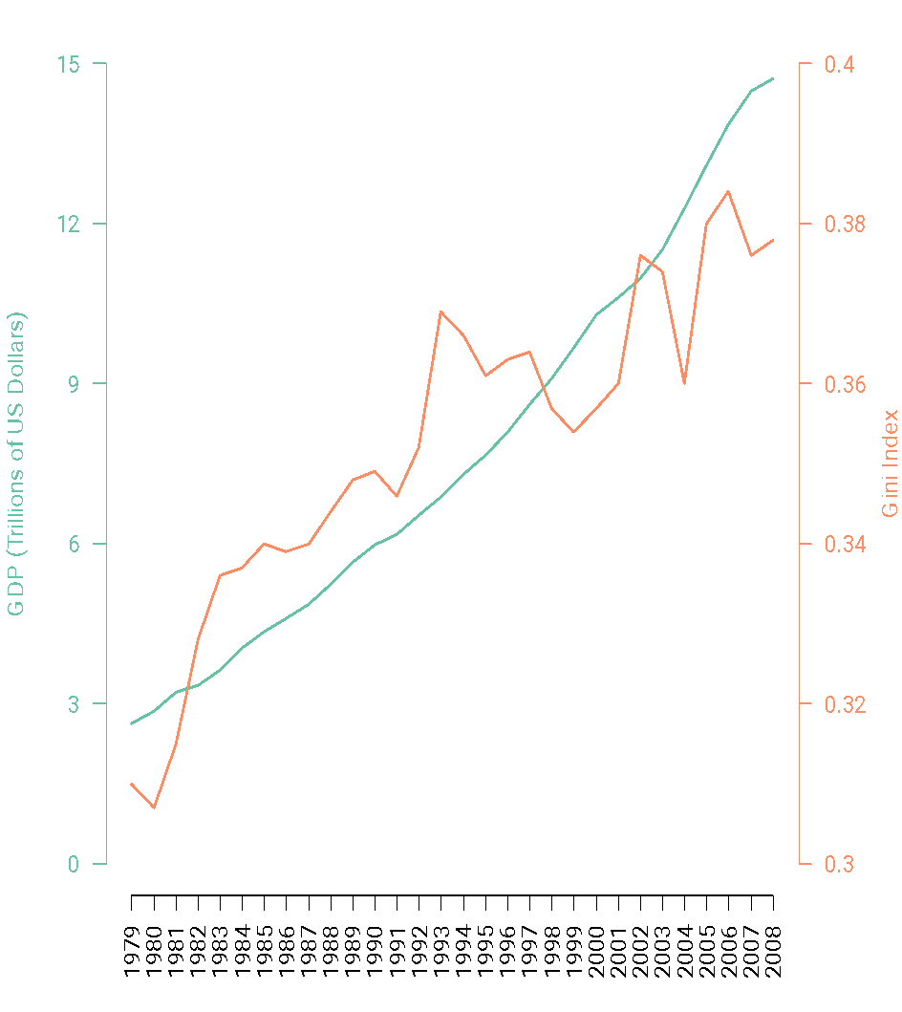
Cartesian coordinate systems
When using multiple axes, using the same color for the visual cue and the axis often help the reader understand the visualization better.
In this case I would have used green instead of black for the top axes (reserving black for the context material). Why?

Slide 19
Polar coordinate systems
Defined by an angle of inclination θ (0° – 360° or 0 – 2π radians) with respect to a reference axis, plus the radius (distance to the origin) r.
Not as easy to understand. Distances are not necessarily measured by a straight line:
For points that are equidistant to the origin, the appropriate distance usually is the angular distance rather than the distance on a straight line!
We already discussed pie charts, which use it.
It can still be appropriate for some variables.

Slide 20
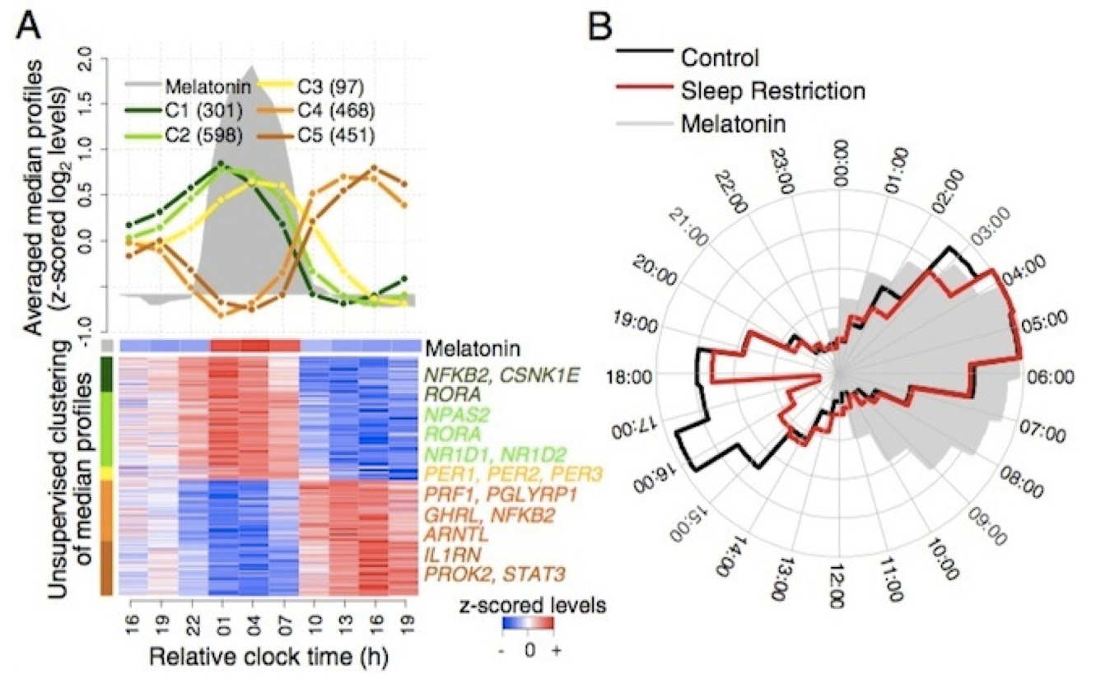
Polar coordinate systems
Polar coordinates are useful for representing cyclic patterns.
In this example (panel B), hormonal levels over the day.

Slide 21
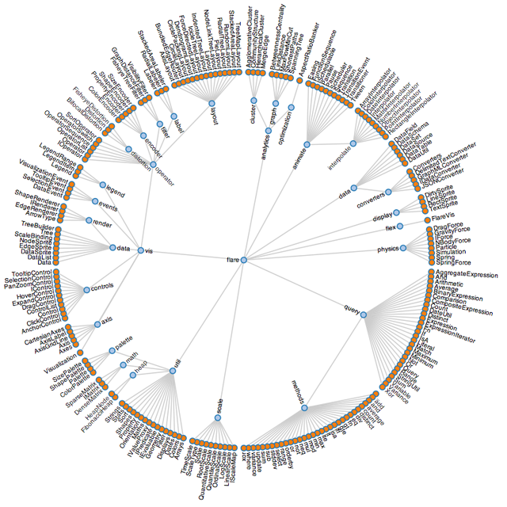
Polar coordinate systems
It can be useful in representing groupings (sometimes called clustering).
No clear sense of beginning or end!

Slide 22
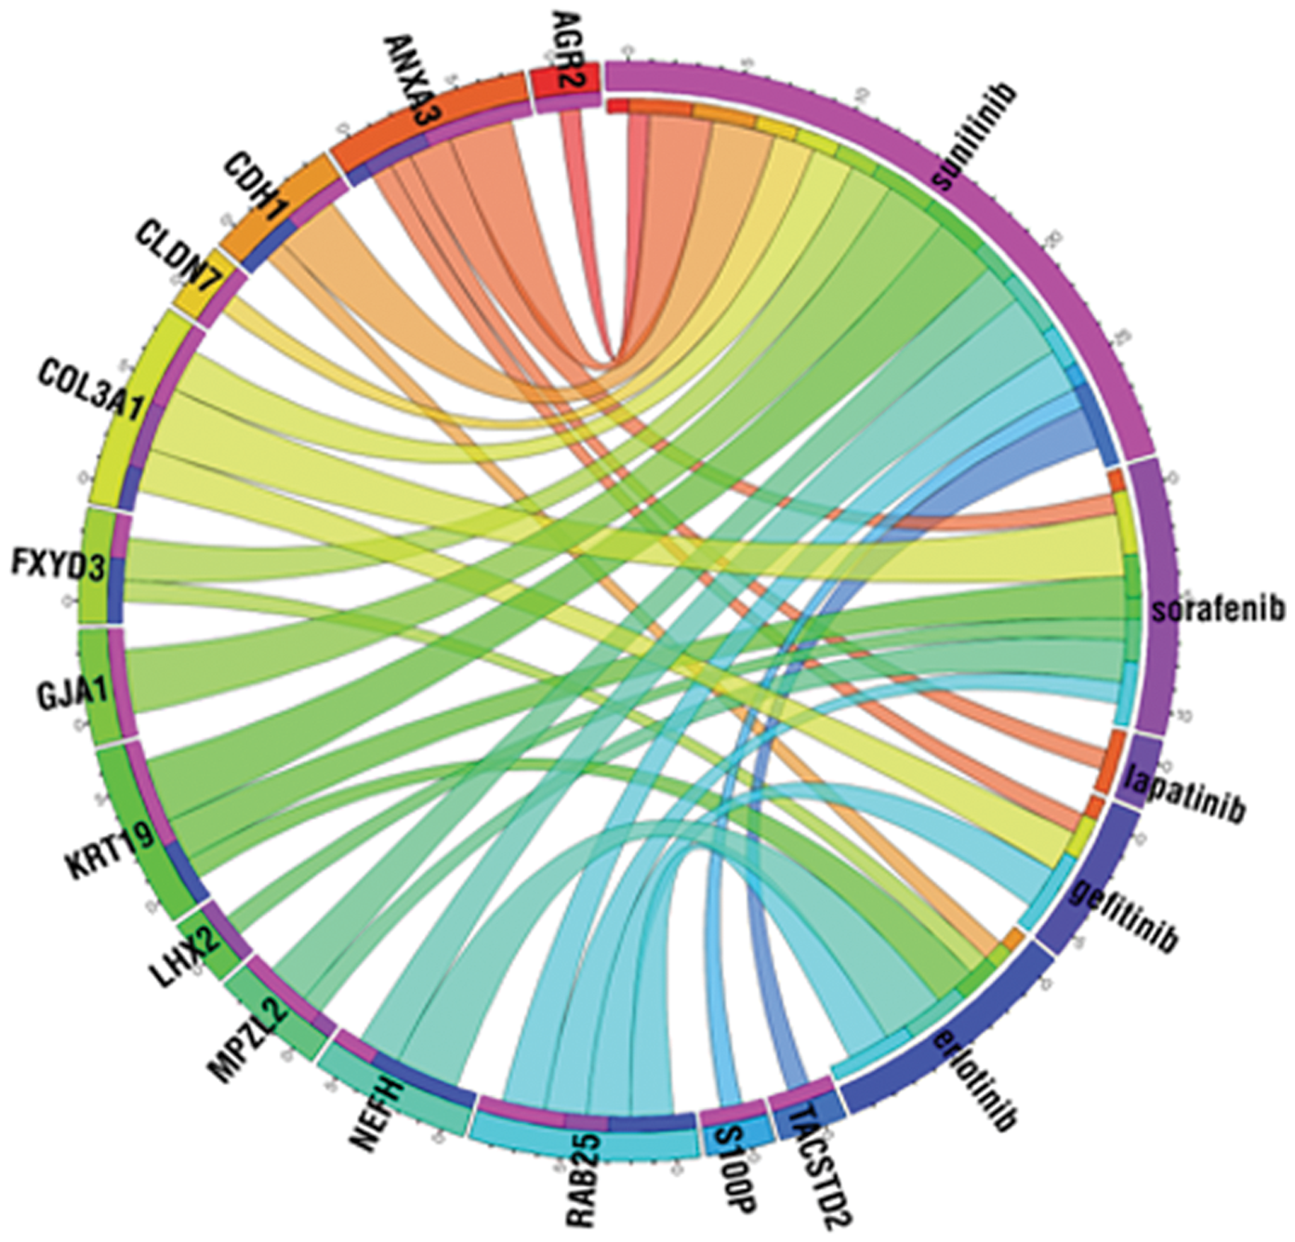
Polar coordinate systems
Another potential useful application of polar coordinates is in representing network data (although this version might be too decorative!)

Slide 23
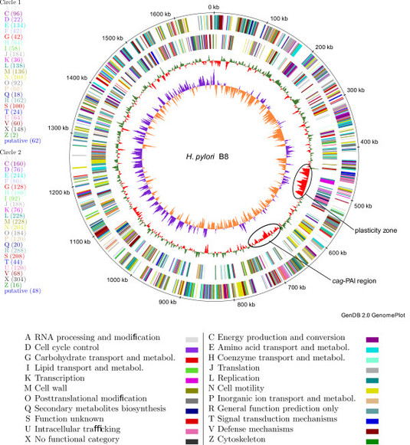
Polar coordinate systems
In this case polar coordinates could be misleading because, with the exception of mitochondrial DNA, DNA in humans is not physically arranged in a circle (ends do not touch).
A placement that reflects physical locations would be more appropriate!

Slide 24
Geographic coordinate systems
Using geographic coordinate systems involve constructing maps.
Maps have the advantage of providing context.
In many cases, geographical location acts as a proxy for unobserved (and/or unobservable) variables, so geographic coordinate systems can provide valuable insights.

Slide 25
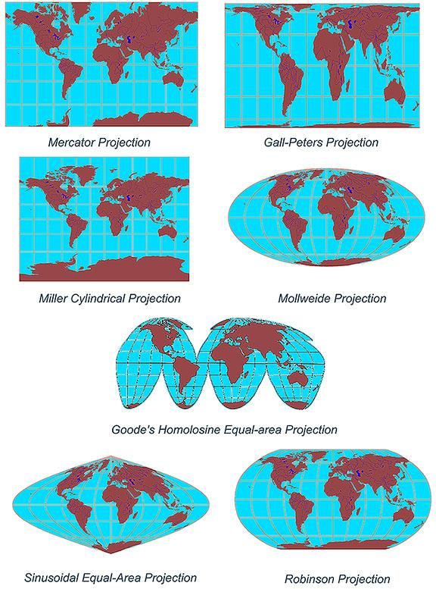
Geographic coordinate systems
Because the Earth is spherical, to construct a map we need to project onto a plane (which leads to distortions).
A large number of projections are available, depending on whether you are interested in preserving distances, angles, areas, etc.

Slide 26
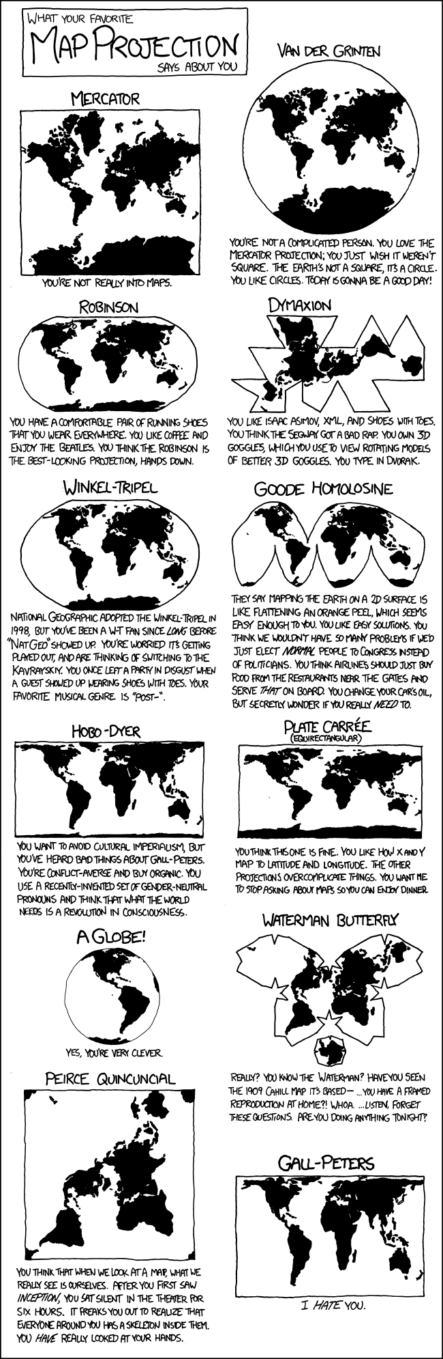
Geographic coordinate systems
Mercator’s and the equicilindridical projections are the most common (Google maps anyone?).
For small regions (e.g., a small county, or even a US state) the specific projection used does not matter much.
For large areas it is very important, and the choice depends on your message!

Slide 27
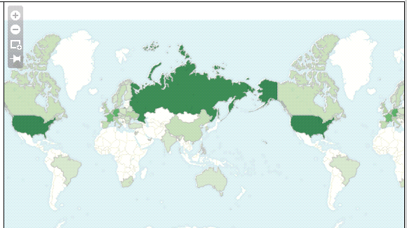
Geographic coordinate systems

Slide 28
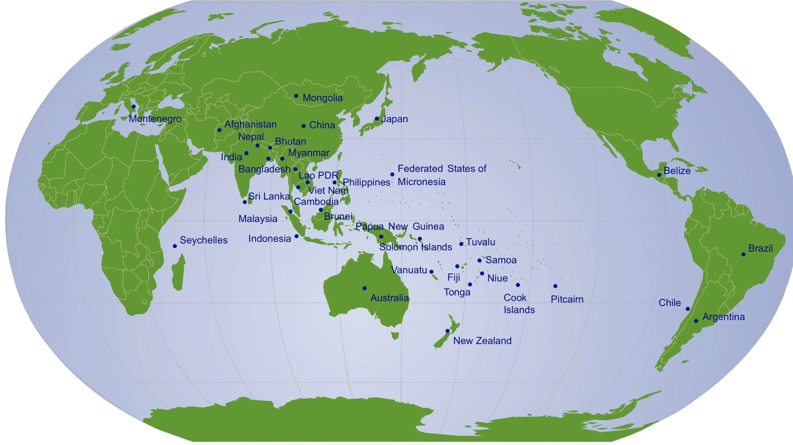
Geographic coordinate systems

Slide 29
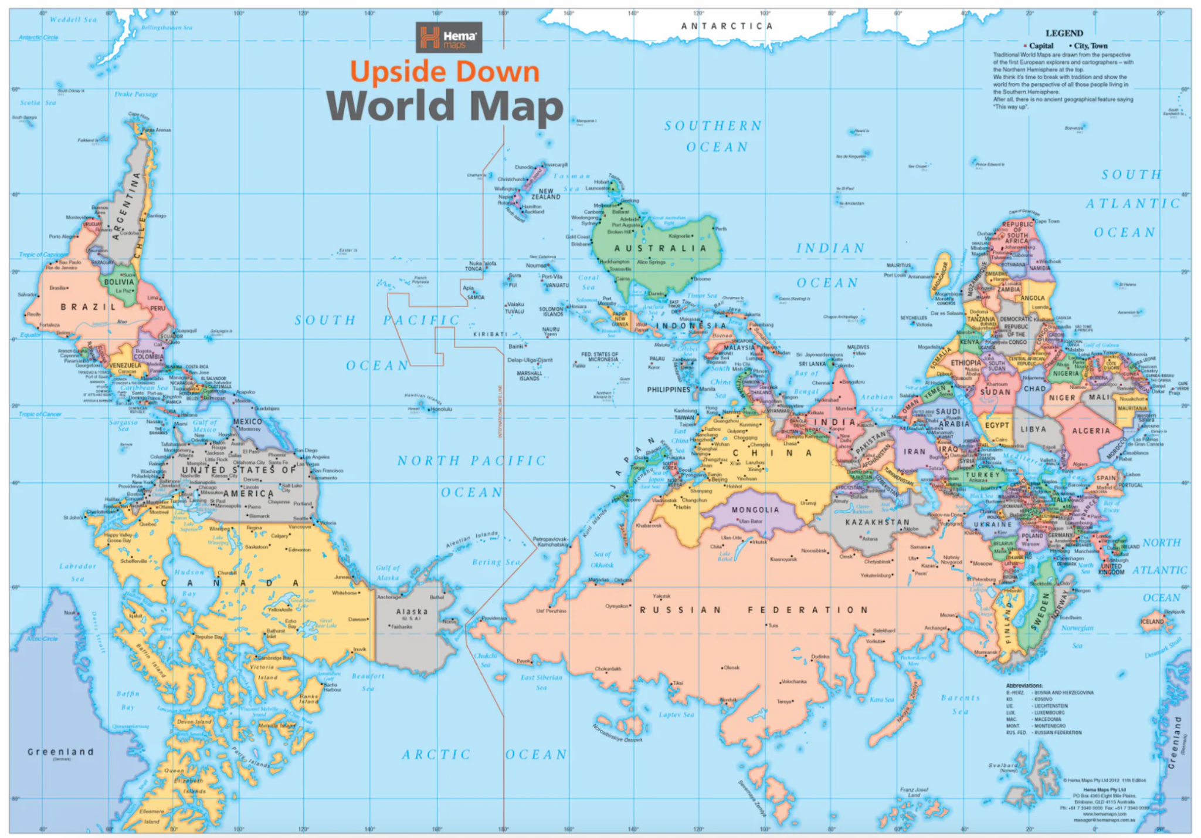
Geographic coordinate systems

Slide 30

Geographic coordinate systems

Slide 31
Scale
While coordinate systems dictate the dimensions of the visualization, scale dictates where in those dimensions your data is placed.
Quantitative scales: linear, logarithmic.
Categorical: nominal, ordinal.
Temporal: time, date, week, year, etc.
Selecting the right scale is every bit as important as choosing the right visual cues!

Slide 32
Linear scale
The linear scale is the one we are most familiar with. A one-unit change in the position/value of the visual cues corresponds to a change of one unit in the variable being plotted.
The beginning and end values of your scale can dramatically alter the message transmitted by the graph.

Slide 33
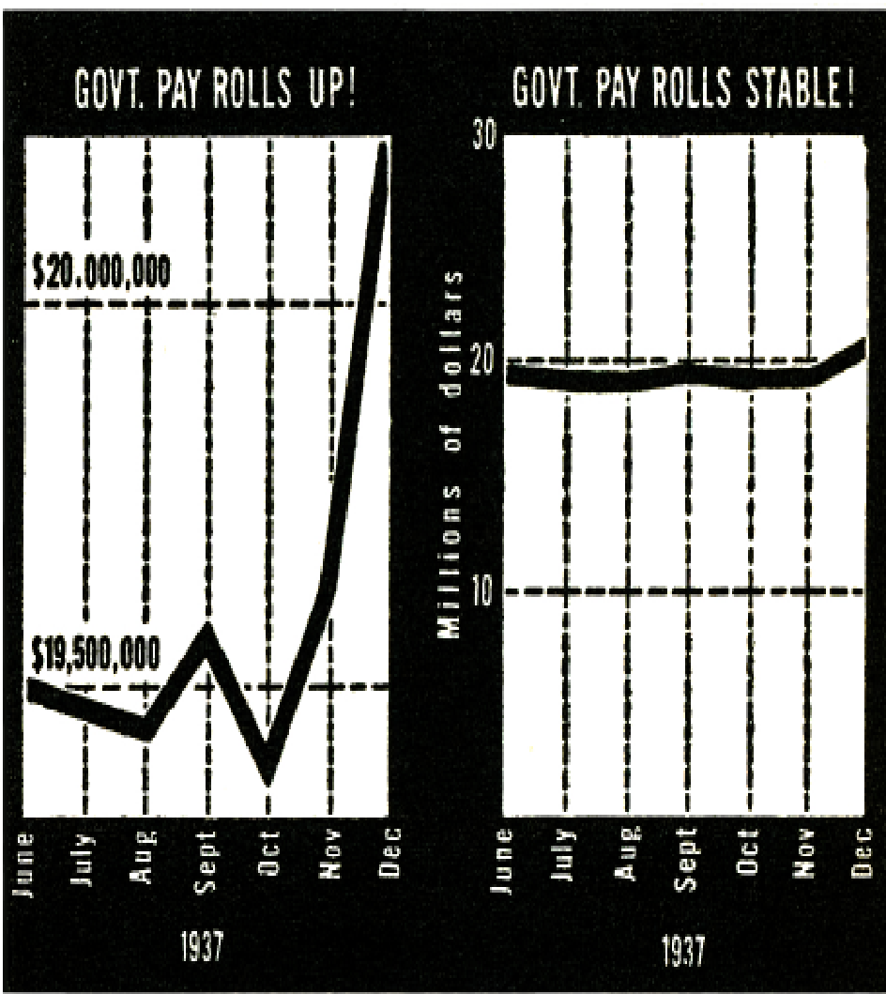
Linear scale
This is a classical example. The data is the same in both graphs, but the message is very different depending on whether the scale starts at zero or not.
From “How to Lie with Statistics” by Huff

Slide 34
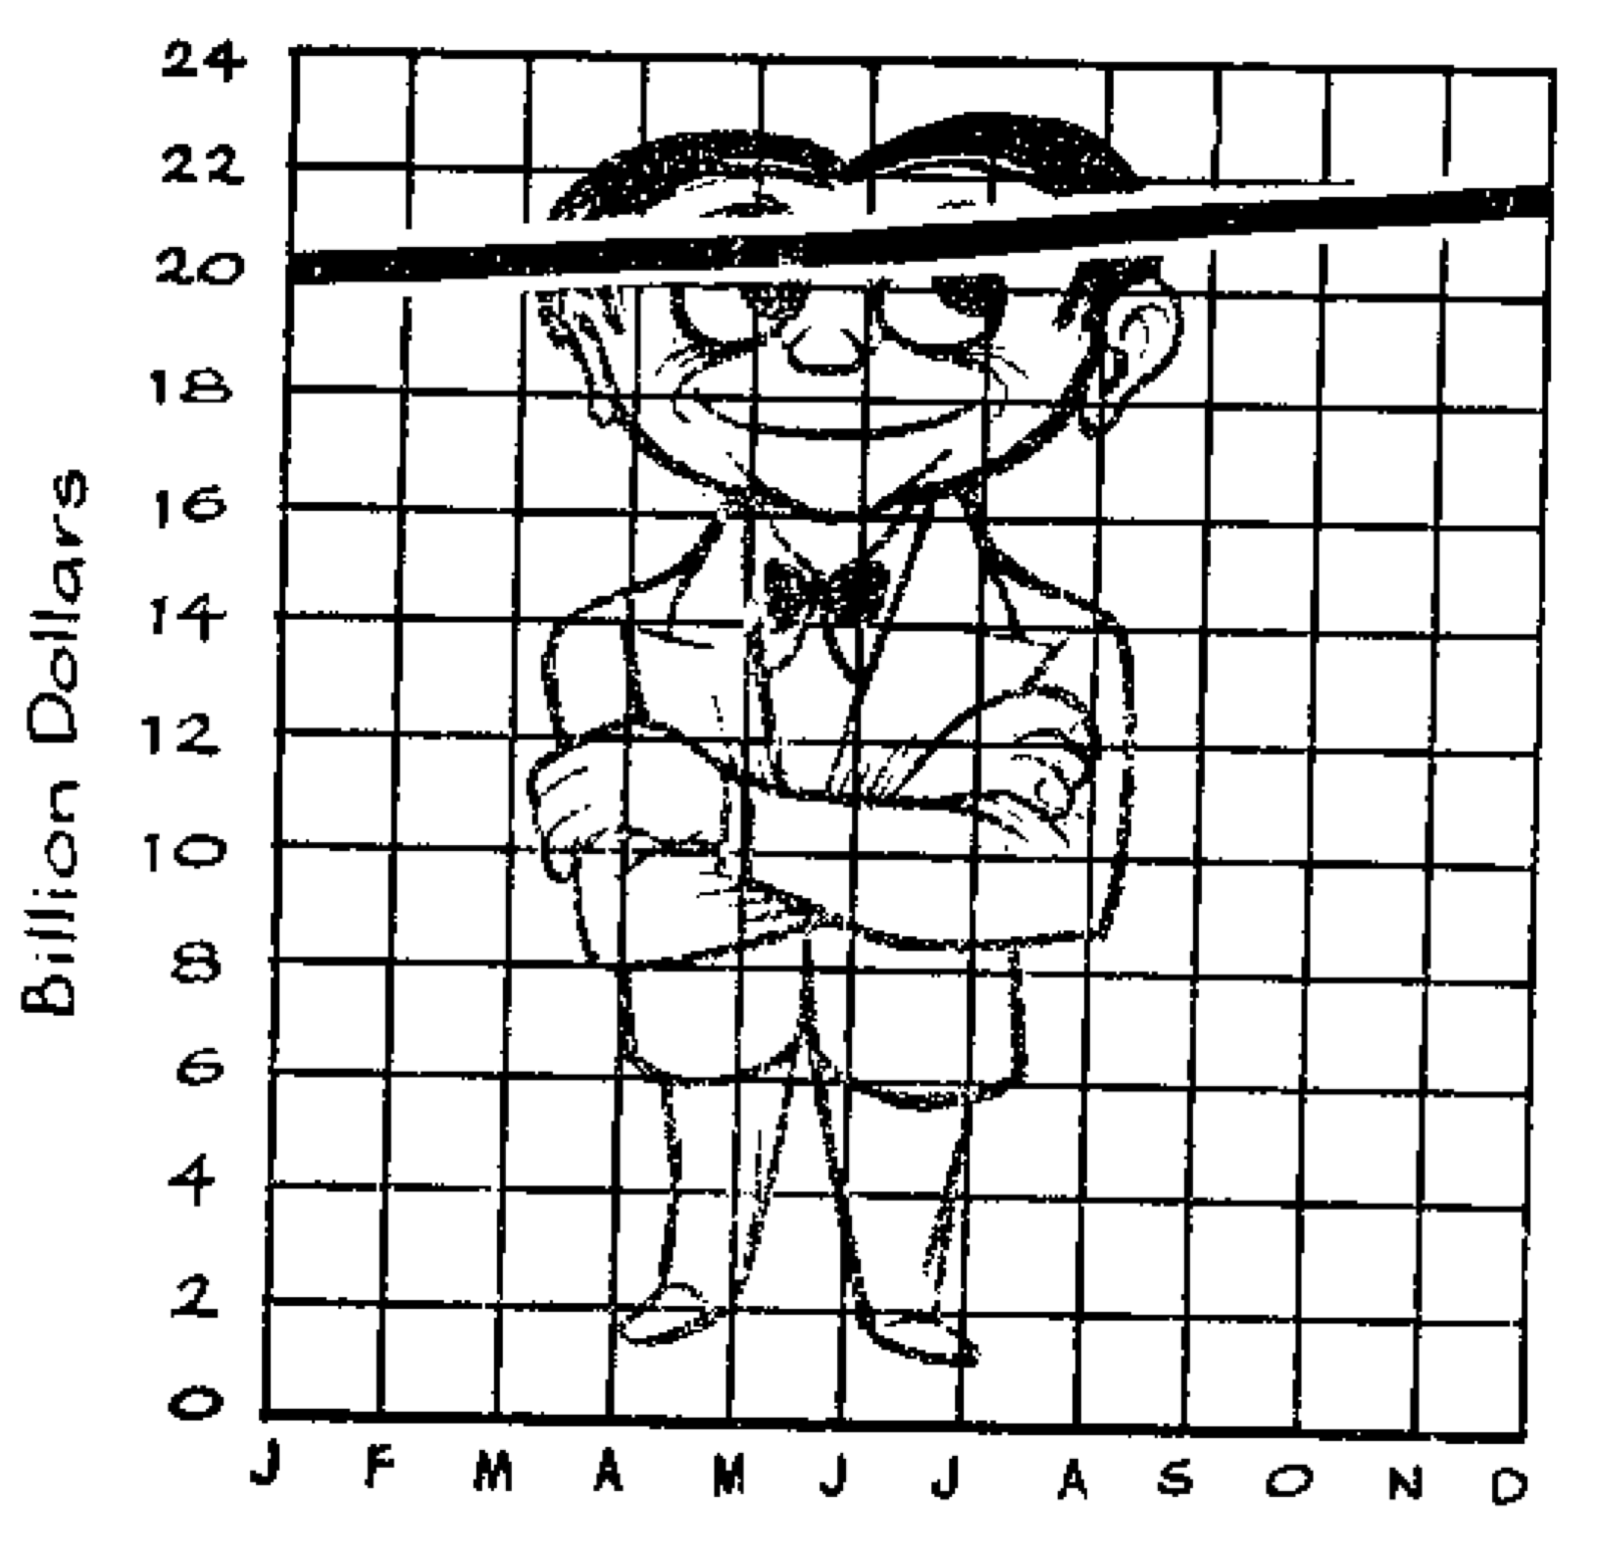
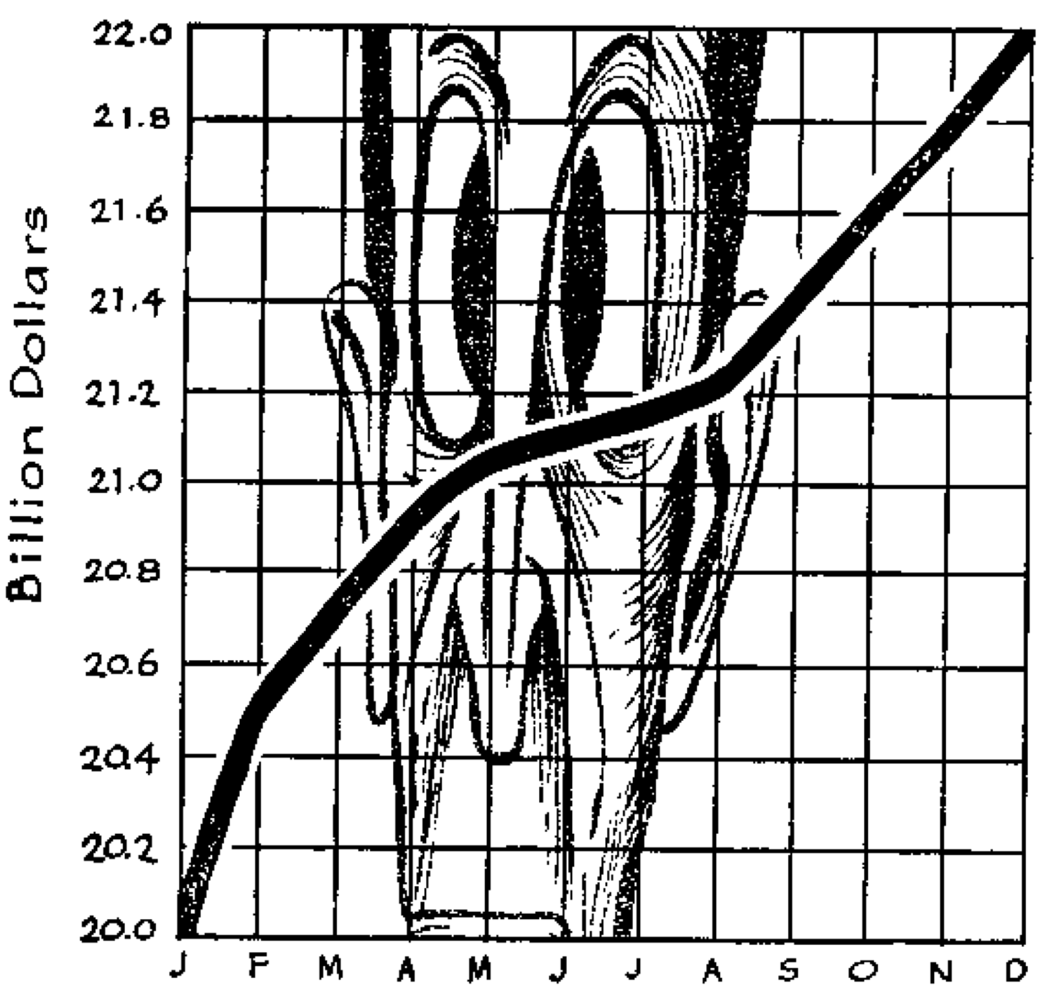
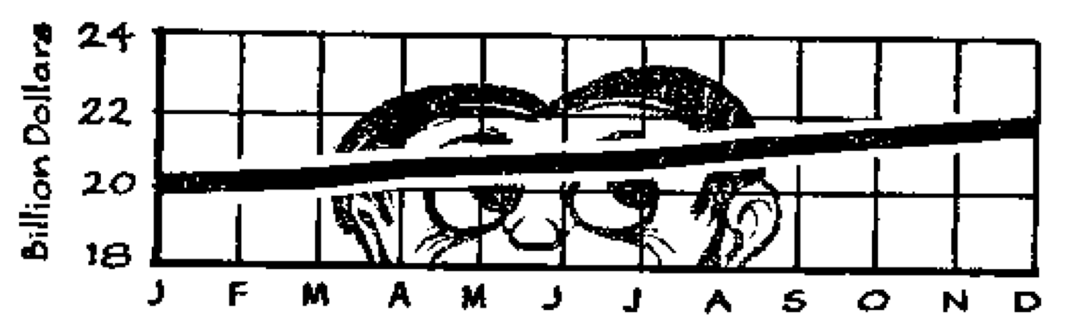
Linear scale
Also from “How to Lie with Statistics” by Huff

Slide 35
Linear scale
A commonly cited rule of thumb is that, when the goal is to compare multiple positive values, linear scales should include zero.
This is done so that the rate of change (proportions) are maintained.
More generally, you need to pick a scale that “makes sense” for the data
What are typical values for the variable you are graphing (e.g., historical values, values from other similar entities)?

Slide 36
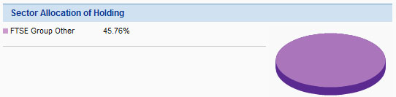
Linear scales
When representing relative frequencies, remember that the values you present must add up to 1.
This is especially critical if you use a pie chart to represent the data.
http://www.perceptualedge.com/example12.php

Slide 37
Logarithmic scale
Unlike the linear scale, in the logarithmic scale the values are not equidistant.
Instead, as the name suggests, it is the logarithms of the values that are equidistant!
It doesn’t really matter what base you use for the logarithm, as changing the bases will only stretch the whole graph in equal ways everywhere (remember the formula for base change in the logarithm!).
More difficult to understand, but some quantities are naturally measured in a logarithmic scale (noise, earthquake strengths).

Slide 38
Logarithmic scale
When using a logarithmic scale, moving one unit on the scale is equivalent to multiplying the previous quantity by a constant (rather than adding a constant, as in linear scales).
For this reason, logarithmic scales can be very useful to represent percent changes.
However, note that you cannot use logarithmic scales if you have both positive and negative numbers in your data.

Slide 39
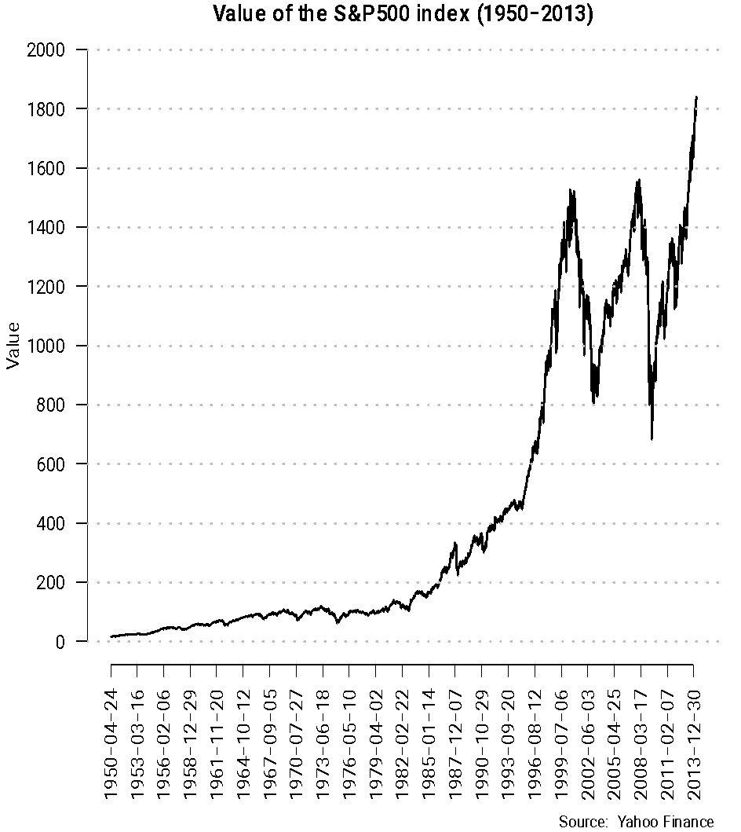
Logarithmic scale
The graph on the right clearly tells you that there was rapid growth in the value of the stock market until early 2000, and then it has zigzagged wildly.
However, if you wanted to tell a story about how long it takes for the market to double its value, this graph is not very helpful …

Slide 40
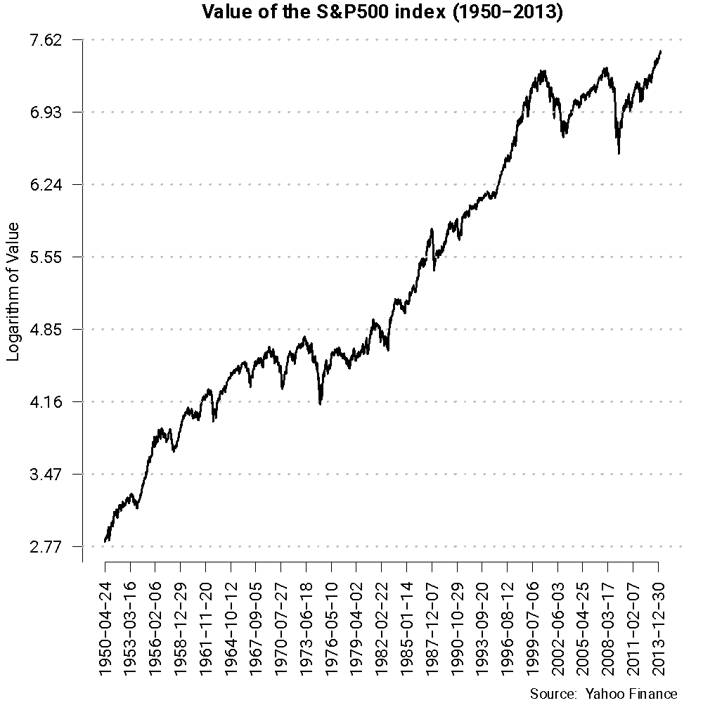
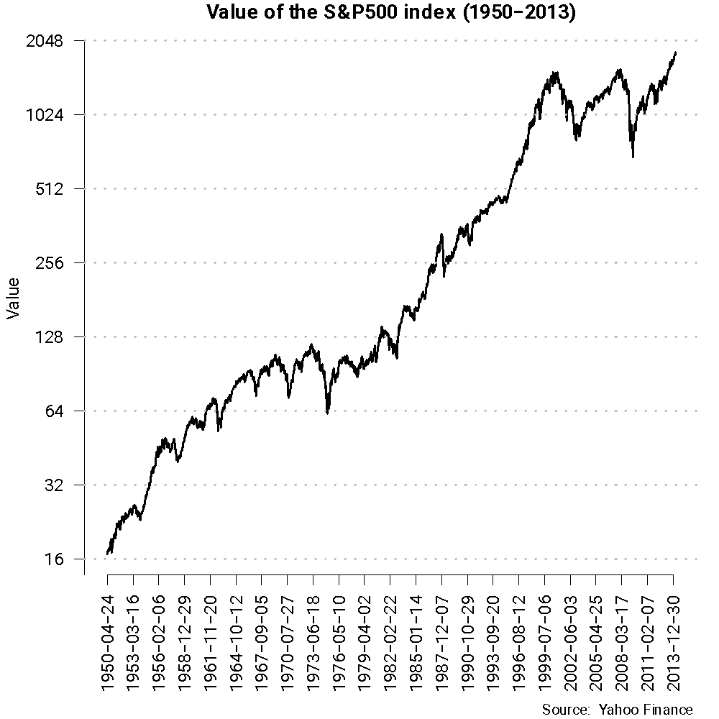
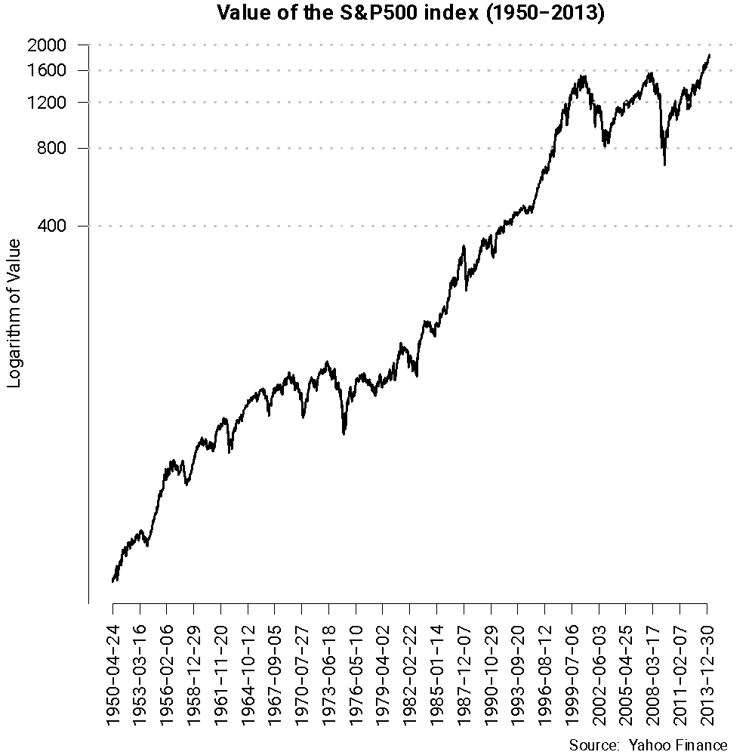
Logarithmic scale
Most common scale
Label axes in the original units!
Zero cannot be included in the axis!
Remember that equispaced guidelines correspond to proportional changes

Slide 41
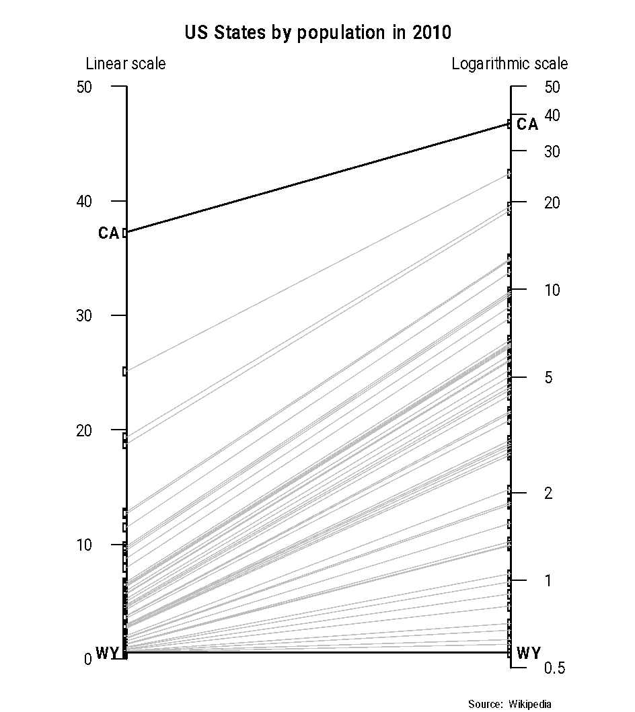
Logarithmic scale
Logarithmic scales can also be useful when the distribution of the values is very skewed (e.g., income, population).
Note the scale is “stretched” for small values and shrunk for large ones!

Slide 42
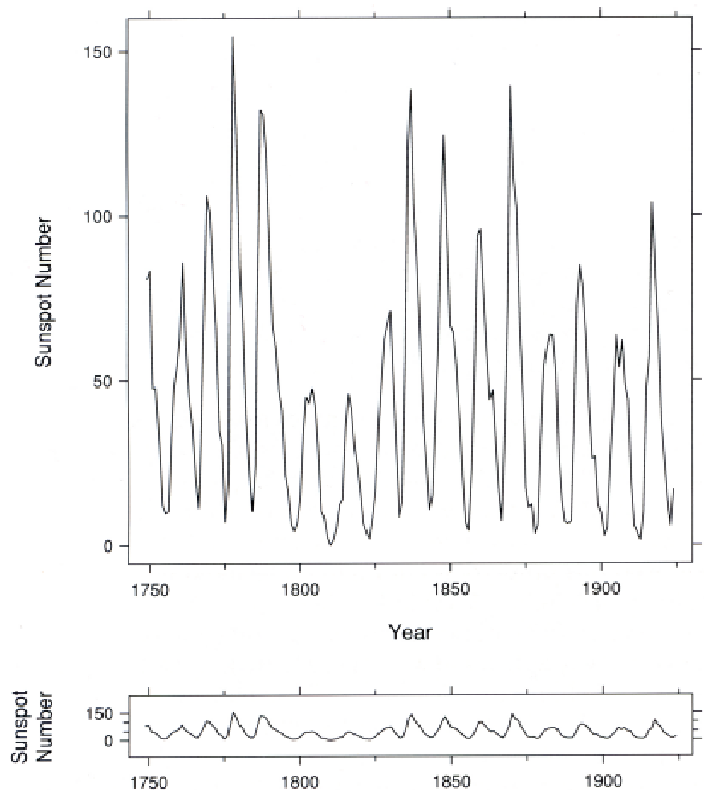
Numerical scales and aspect ratios
The aspect ratio of an image describes the proportional relationship between its width and its height
If the slopes of the graph are important, try to choose a scale and aspect ratio for your plot that makes the slopes close to ±1 (±45°).

Slide 43
Categorical scales.
A categorical scale provides visual separation for the different groups.
Spacing in categorical variables is arbitrary, but should be chosen to improve the legibility of the plot and to allow readers to visually group information.
Space between visual cues should be smaller than the visual cues themselves.
Don’t be cheap! “Negative” (i.e., white) space can make visualizations clearer.
White space between bars in a bar plots is important to avoid confusion with a histogram.

Slide 44
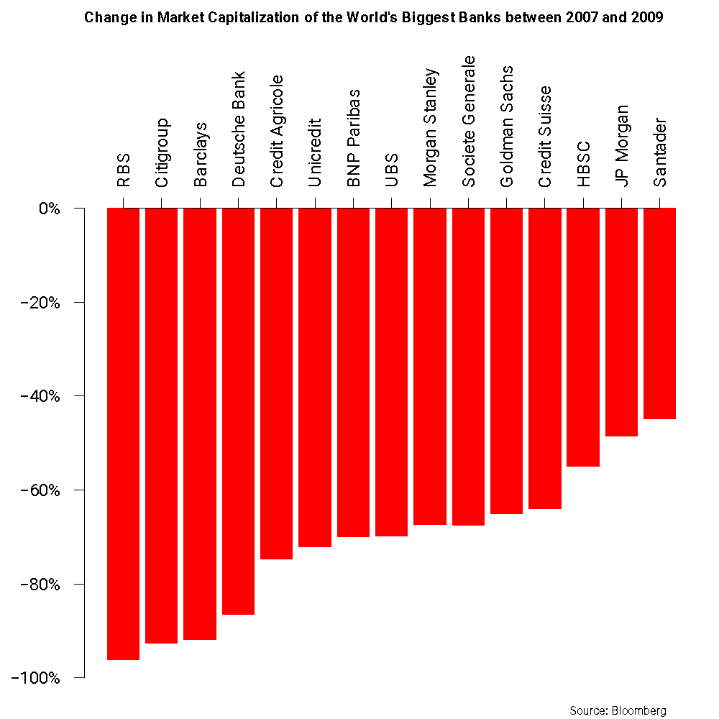
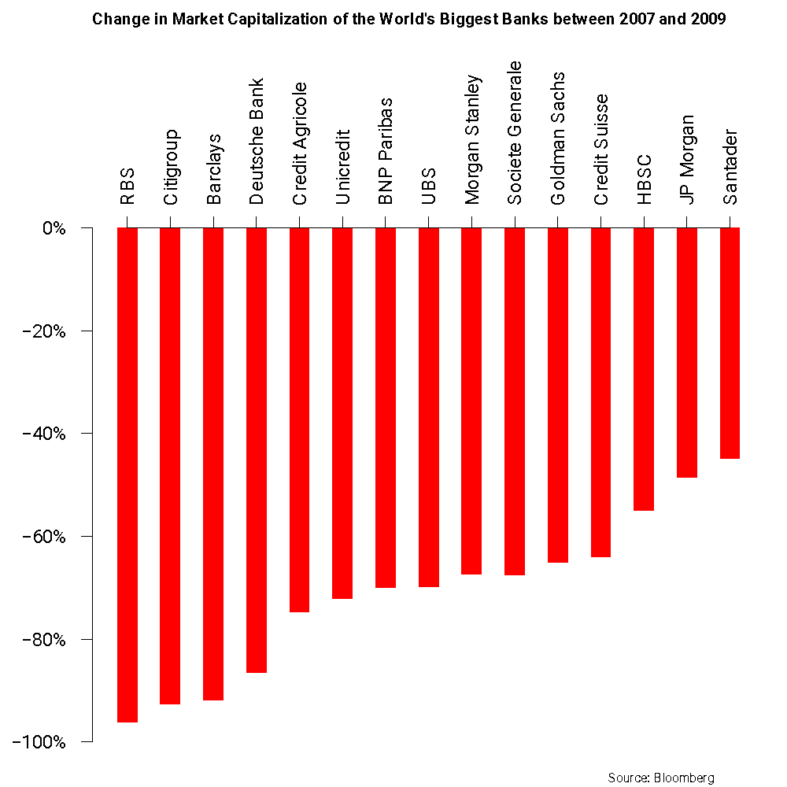
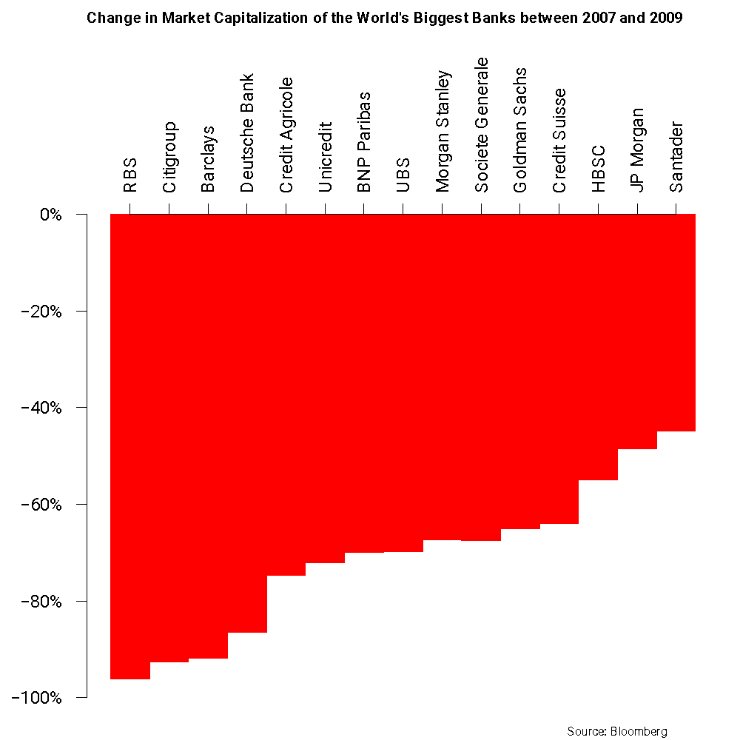
Categorical scales
About the right amount
of space between bars
Too much space between
bars
No space between bars
Space in between bars is about
20% of the width of the bar
Arguably, less visually appealing

Slide 45
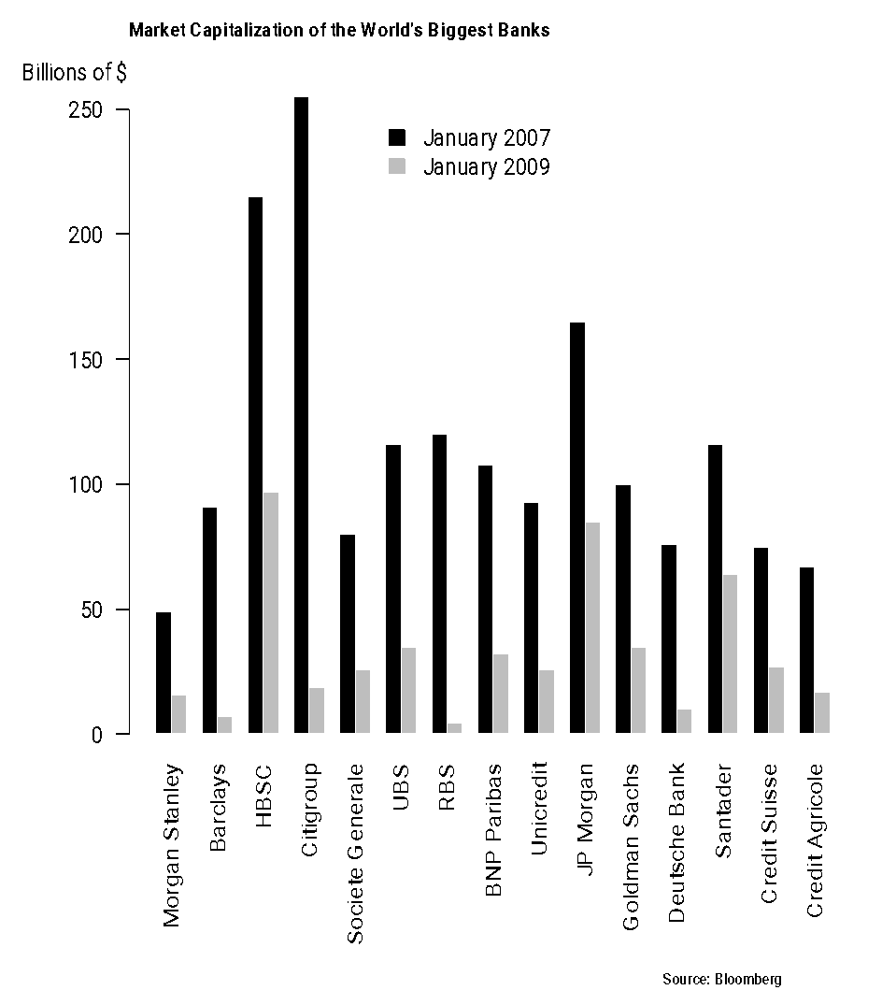
Categorical scales
Different spacing can be used to differentiate between groups of values.

Slide 46
Categorical scales
In nominal variables, the order of the categories is also arbitrary! Use this to improve the visualization:
“Diagonalization” (ordering the categories from the most to the least frequent, or vice versa) improves legibility.
If multiple variables are plotted simultaneously, then there might be multiple ways to diagonalize. Choose the ones that makes the point of the visualization clearer!

Slide 47
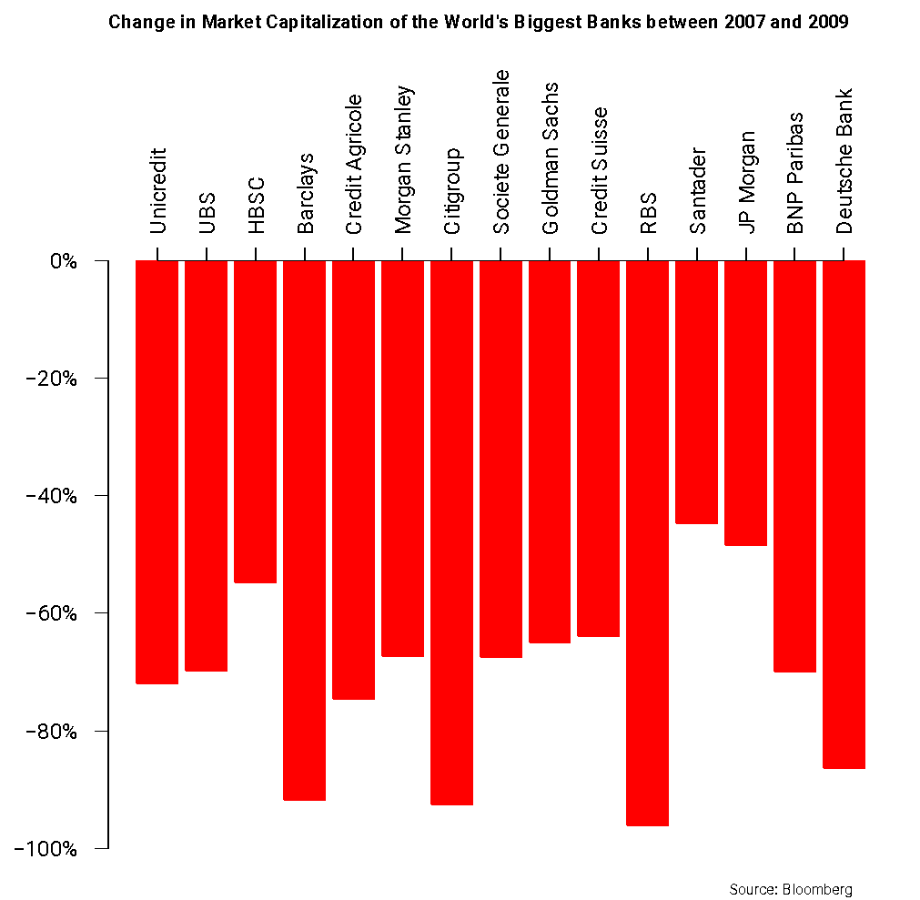
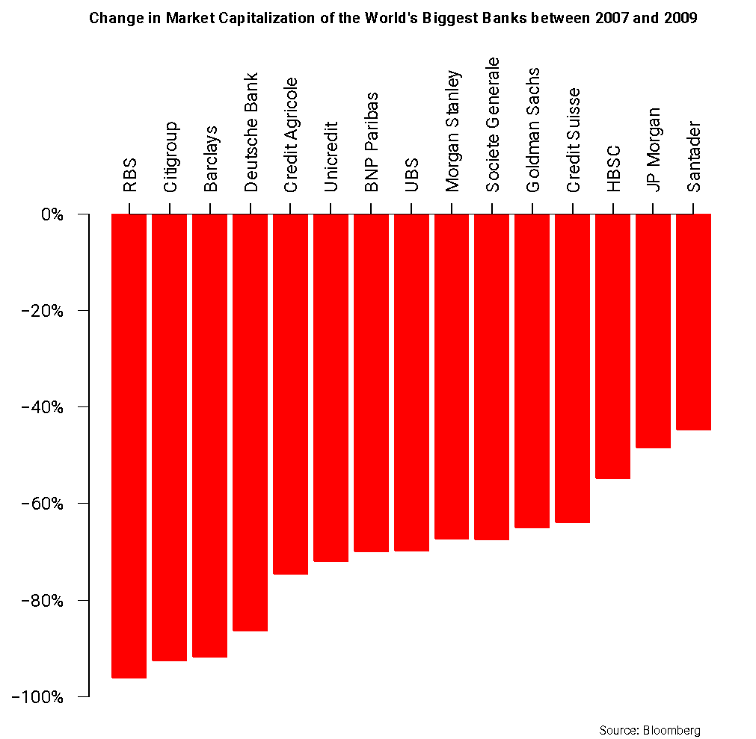
Categorical scales
Random order for categories
Diagonalized graph

Slide 48
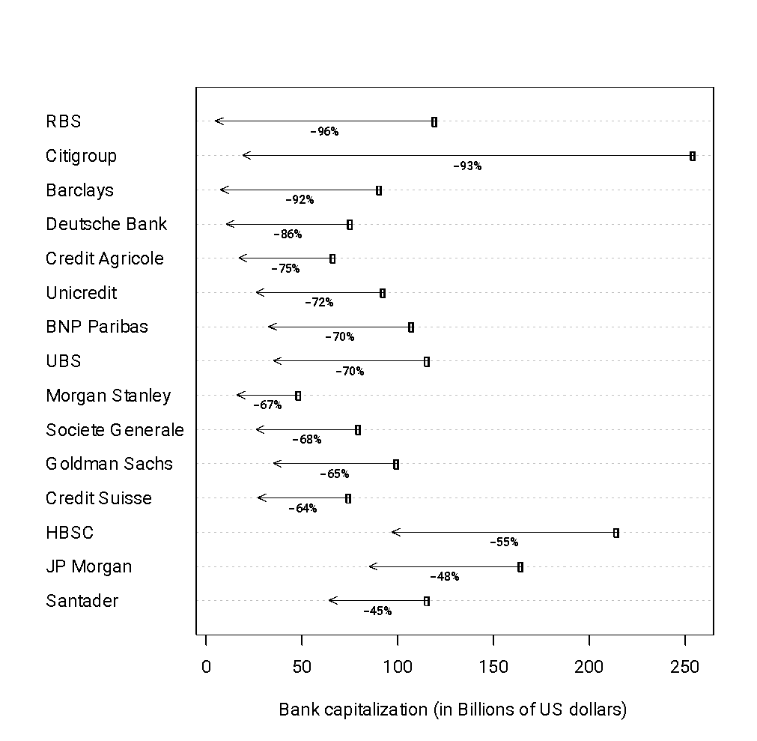
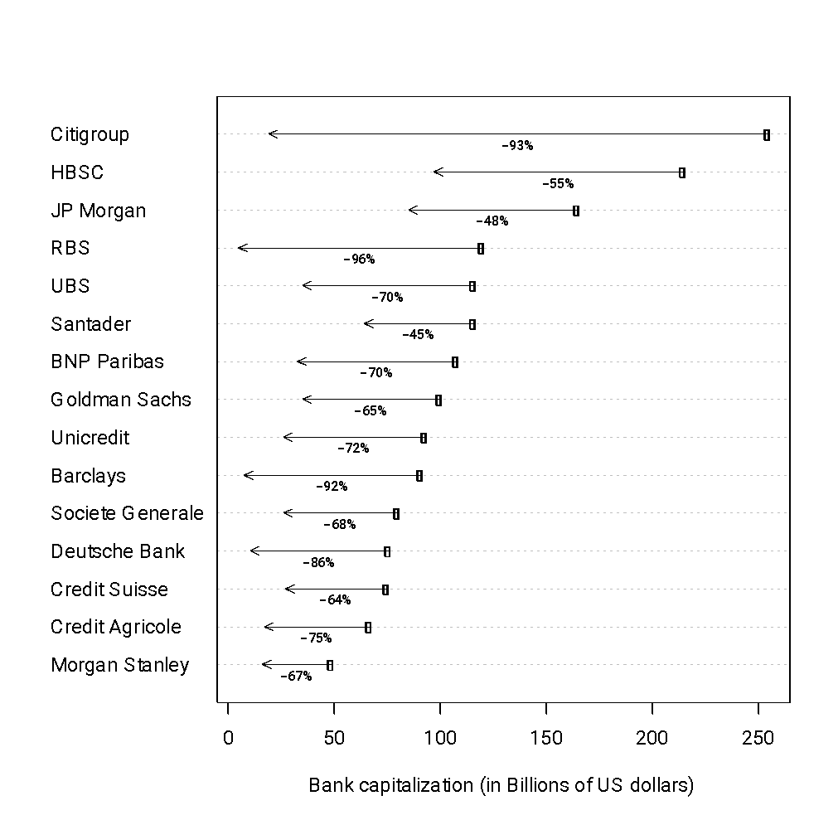
Categorical scales
Diagonalized according to % change
Diagonalized according to January 2007 value

Slide 49
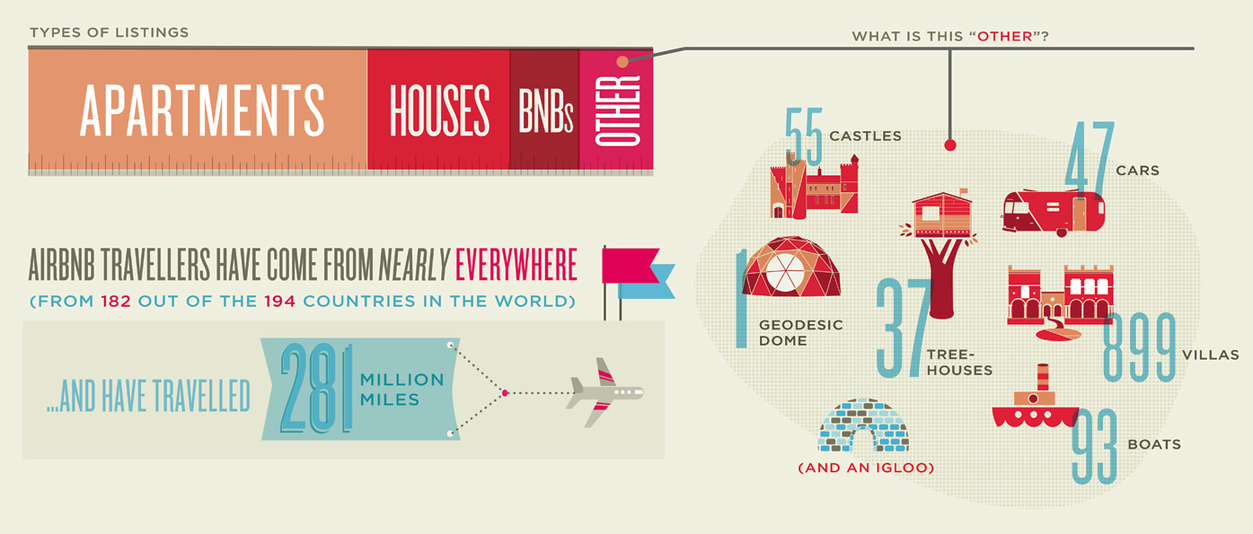
Categorical scales
Too many categories with some having very small counts compared to the rest can make your dot plot or bar plot hard to read.
Consider combining minor categories into a group called “Others”, which you can explain separately!
Note that there is an axis,
but the scale is missing!

Slide 50
Categorical scales
However, if the data is ordinal it is important to preserve the natural order of the categories.

Slide 51
Temporal scale
Temporal scales might be treated either as continuous (e.g., if exact time of events is available) or ordinal (if we somehow aggregate over periods such as months, quarters, etc).
Sometimes temporal scale might be implied by visual cues rather than represented explicitly.

Slide 52
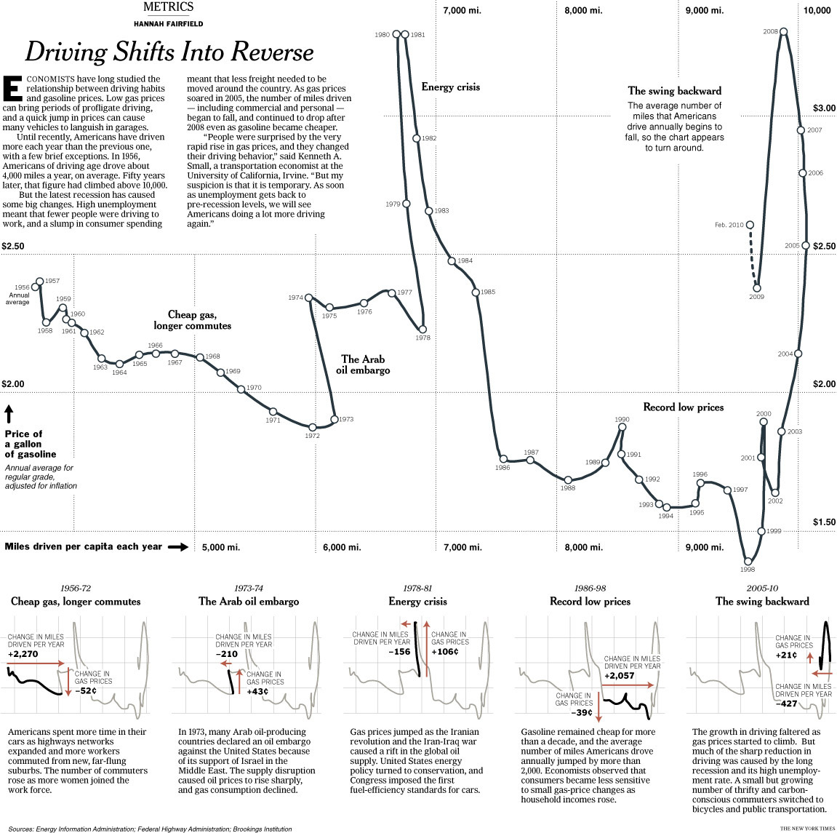
Temporal scale
In this case, the temporal nature of the data is implied by the line used to connect the points.
For the mathematically inclined: The line is probably generated using a parameterized curve and interpolating splines!

Slide 53
Context
Most visualizations require some additional information (units of measurement, source of the information, etc.) to make them understandable.
Make sure contextual elements are less prominent than the visual cues associated with the data.
The context is often provided through text (I will be focusing on this type of context in the following discussion), but, in some cases it can be provided by graphical (lines, enclosures) or decorative elements.
This is the one place where a bit of decoration has a potential to improve your visualization!

Slide 54
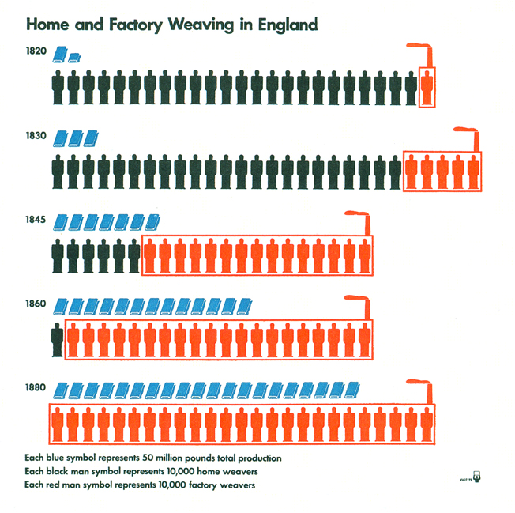
Context
Here, context is provided mainly by the title and the legend at the bottom of the graph.
However, note that context is also provided in part by the use of a small chimney to denote factory workers!

Slide 55
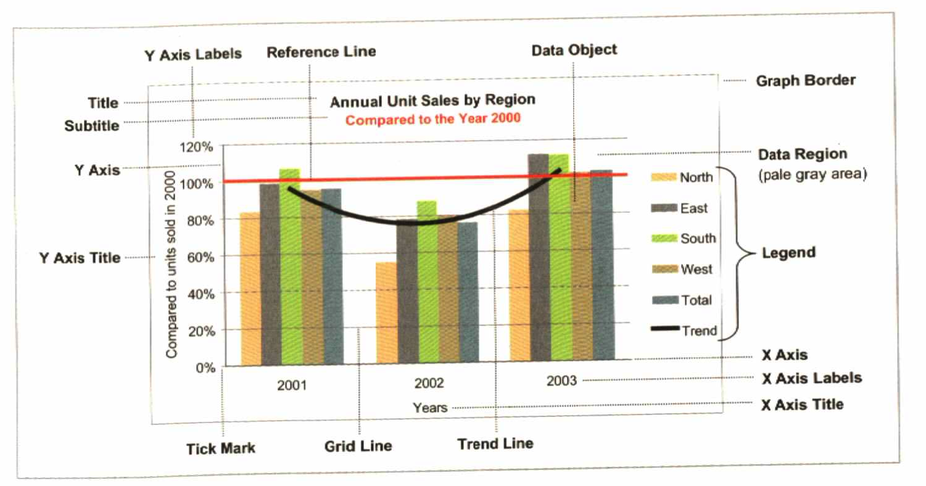
Context

Slide 56
Context
Title and subtitle:
A title should always be included.
If you include both a title and a subtitle, you can either one of them as a punch line for the main message of the visualization!
“Diamond’s were a girl’s best friend – Average price of a one-carat D-flawless”

Slide 57
Context
Axes labels:
As a general rule they should be included, but be alert to situations where they can be dropped.
Horizontally oriented labels improve legibility (but they might also take more space, so they are often shunned in many scientific publications).
The sideways y axis label
is difficult to read
The x axis label “Years” could be
eliminated without compromising
the legibility of the plot

Slide 58
Context
Legend:
Always include an explanation for colors/line types/line width/shapes used in your plot, either through a legend or as direct labels in the graph (if objects are grouped).
Can be included as part of the plotting region if they do not interfere with perception, otherwise outside.
Avoid surrounding the legend with a frame (it is just visual clutter and draws attention to a context item rather than the data).
In some cases a horizontally rather than vertically arranged legend is preferable.

Slide 59
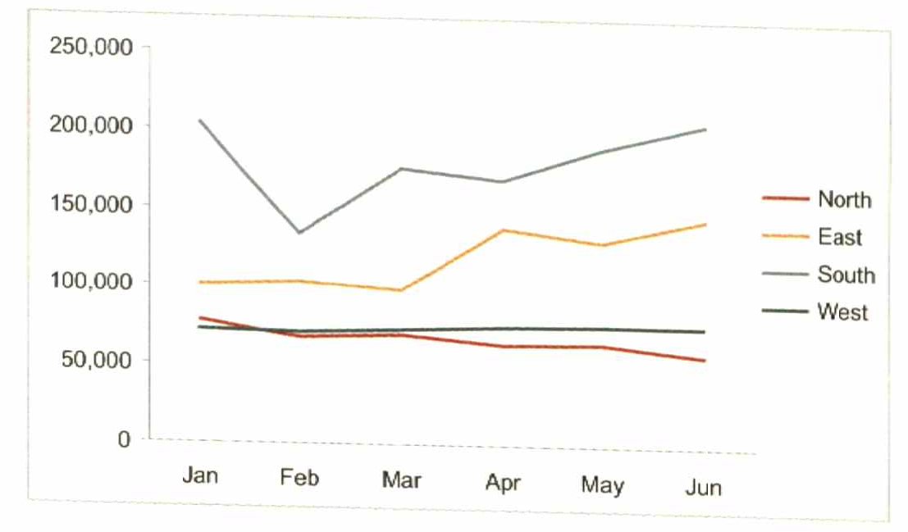
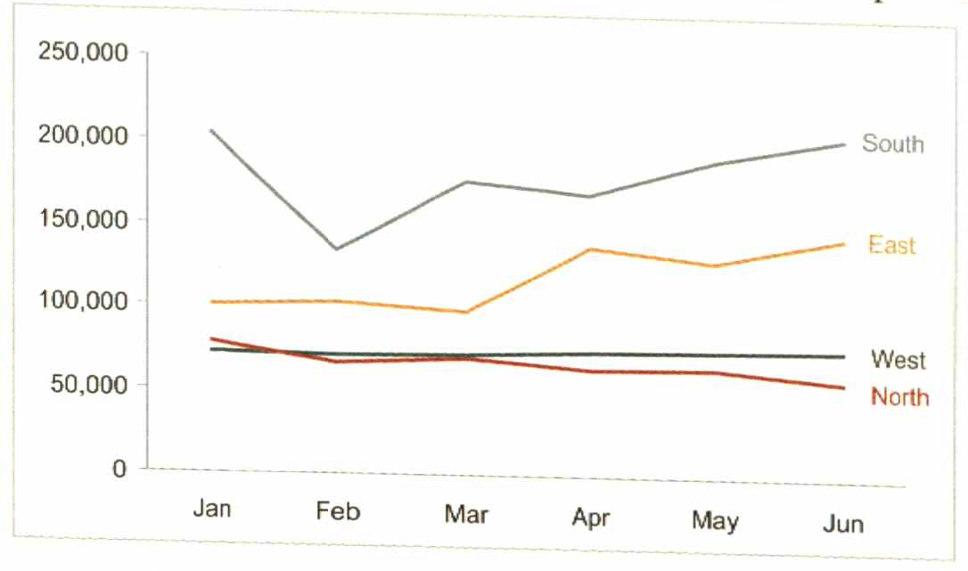
Context
Ok
Better
Here, the legend can be replaced by labels placed directly on the graph
(which are a better solution in this case)

Slide 60
Context
Grid lines can fulfill three different roles:
Enhance the look-up of values.
Enhance the comparison of values (particularly in large graphs!)
Enhance perception and comparison of localized patterns.
Make sure they are not more prominent than the main lines in the graph!

Slide 61
Context
Highlights:
Highlighting certain data points can help make a point.
A number different ways to highlight (recall our discussion of pre-attentive attributes).
Elements at the top, the left or the center of the visualization tend to be visually more “important”. These positions can be used to highlight certain elements. For example, if we want to highlight the state with the highest unemployment, we should order the data from high to low and place that state at the top.

Slide 62
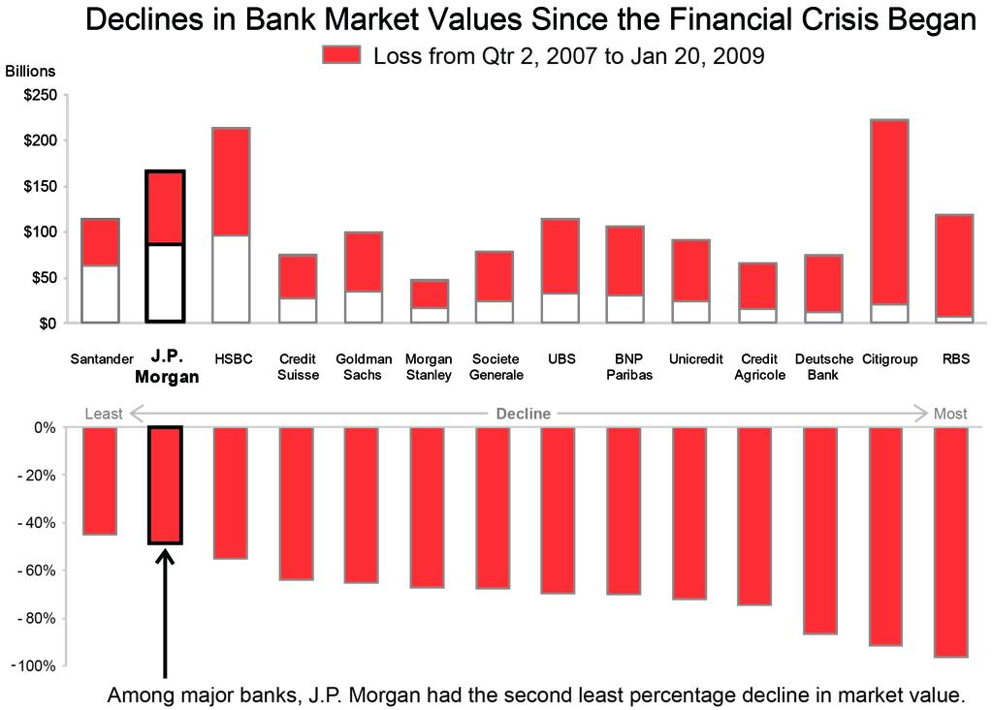
Context
J.P. Morgan ostensibly prepared their original visualization to show that they weathered the financial crisis better than the competition!
This is highlighted by:
Enclosure of J.P. Morgan’s bars.
Ordering from low to high percent loses.
Bold fonts for J.P. Morgan.
Arrow and explanation.
You could have used a different color too (overkill?).

Slide 63
Context
Trend and reference lines:
A trend line reveals the general direction that a group of points seem to be heading. It could be considered a highlight element!
Reference lines provide information about what “normal” values are (either based on data, like means medians or quantiles, or based on external information such as a target number), or mark a point of interest among qualitative variables.

Slide 64
Context
State with the highest change in unemployment on top
Reference line

Slide 65
Context
Other support components:
Include raw numbers if possible.
Mention the source of your data.
Pick font sizes that are proportionate to the medium employed for display!
Explicative captions are important, particularly if your graph is complex.
Border for the figures might be useful, but they are not required.

Slide 66
Putting it all together
Creating the visualization means combining the four types of elements discussed above:
Some combinations are very common (e.g., position on a Euclidean space with linear axes), others not so much (polar coordinate system that uses a logarithmic scale).
When “mixing” your ingredients, remember the visualization wheel, particularly the originality/familiarity axis!

Slide 67
Putting it all together
When creating your visualization:
Group the data: visually (or explicitly!) segment the data into meaningful subsets.
Prioritize the data: rank the data by importance. Hierarchical organization of the graph:
Top, left and center of graph are focal points. Place most important information there.
Saturated colors draw attention.
Enclosures and other visual clues draw attention.
Sequence the data: give direction for the order in which the data should be read.
Pages 120-125 of Few’s “Show me the numbers”.

Slide 68
Additional recommendations for putting it all together!
Negative space can help with visual separation and groping.
Vertical and horizontal alignment of figures and/or text is important for clear visual flow and to facilitate comparisons (particularly across multiple graphs).
Use the same scale for similar variables on different graphs to facilitate comparisons.

